Slide 1
Nouvelles Approches dans le SCA ST- Faut-il réaliser une revascularisation complète ?
Michel Zeitouni, MD PhD
Sorbonne Université Action Study Group Hôpital Pitié-Salpêtrière
Présentation disponible sur www.action-coeur.org

Slide 2
Speaker's name : Michel Zeitouni, Paris
☑ I have the following potential conflicts of interest to report:
Research Grants : Fédération Française de Cardiologie, Institut Servier, Action Cœur
Honorariums : BMS/Pfizer, Bayer, AstraZeneca

Slide 3
Should we aim for a complete revascularization in NSTEMI ?
Should we treat non-culprit lesions in NSTEMI ?
Should complete revascularization be guided by coronary physiology ?
What timing for complete revascularization ?
What about NSTEMI with cardiogenic shock ?

Slide 4
Should we aim for a complete revascularization in NSTEMI ?
Should we treat non-culprit lesions in NSTEMI ?
Should we be guided by coronary physiology ?
What timing for complete revascularization ?
What about NSTEMI with cardiogenic shock ?

Slide 5
Culprit Lesion in murine model
STEMI
NSTEMI
#1 Tissue Factor
#2 Platelets
#3 Fibrin
Bruce and Barbara Furie . N Engl J Med 2008;359:938-49

Slide 6
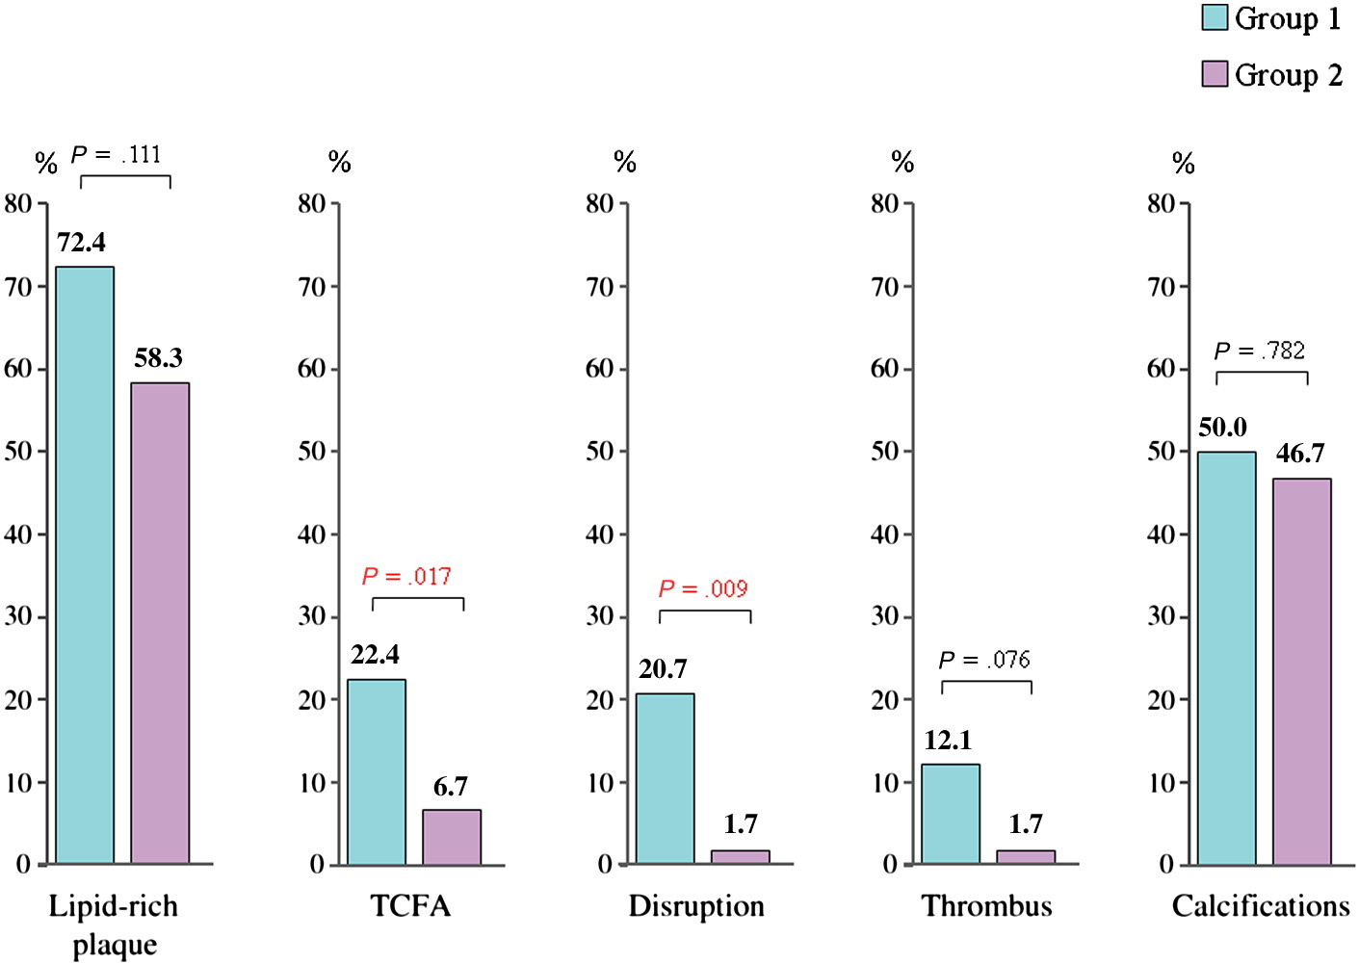
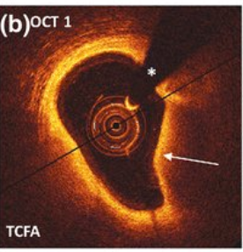
Culprit Lesion vs. Non-culprit Lesion
Pan-coronary OCT
38 patients with 3-vessel disease and ACS
TCFA
Thin-cap fibroatheroma characterized
=
large lipid pool with overlying thin fibrous cap
Responsible for ACS andd sudden cardiac death
Vergallo R et a. American Heart Journal. 2014;167:59–67.

Slide 7
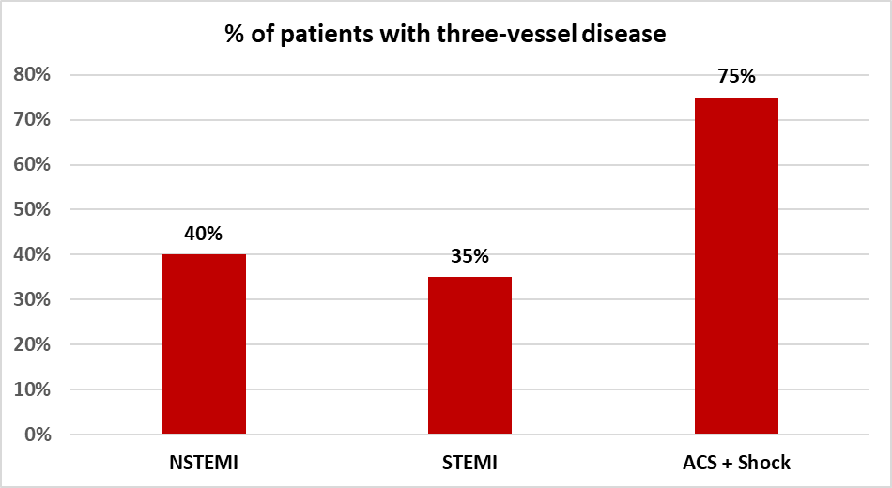
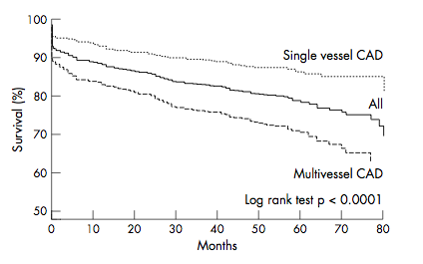
NSTEMI and multivessel disease : a frequent and high- situation
Seo SM et al. Coron Artery Dis. 2012
Parodi and al, Heart 2005

Slide 8
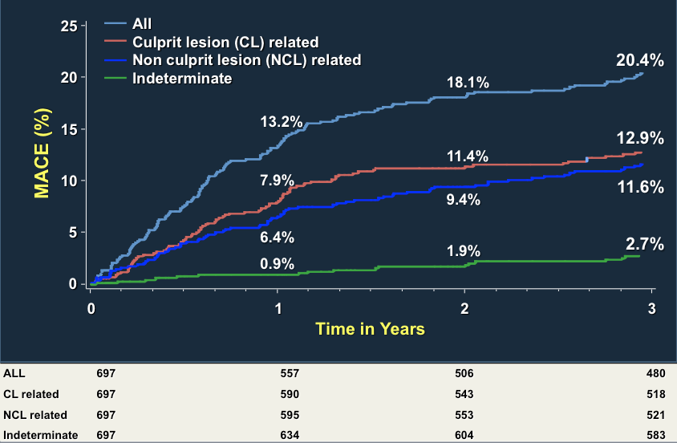
Are non-culprit lesions really innocent ?
PROSPECT trial : half of future MACE are related to non-culprit lesion
Stone G et al. N Engl J Med 2011;364

Slide 9
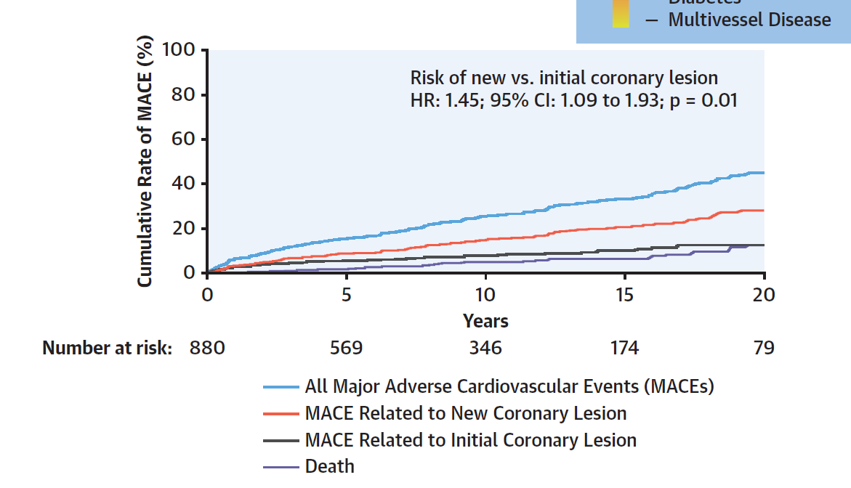
Are non-culprit lesions really innocent ?
Premature coronary artery disease
65 % of ischemic recurrences related to non-culprit sites
Collet JP, Zeitouni M et al. JACC 2020

Slide 10
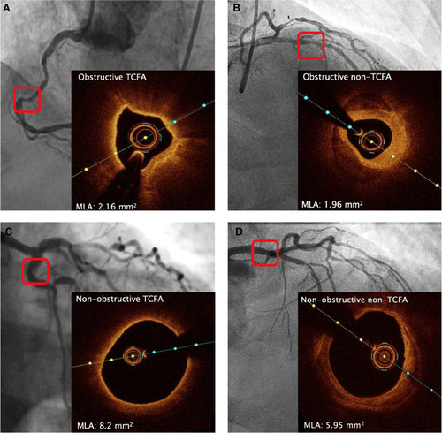
Are non-culprit lesions really innocent ?
OCT analysis of non-culprit lesions in the COMPLETE Trial
50% with at least 2 vulnerability criteria (intraluminal defect, ulceration, irregular plaques, dissection)
High rate of thin-cap fibroatheroma
Especially in obstructive lesions (> 50 %)
Natalia Pinilla-Echeverri. Circulation: Cardiovascular Interventions. Nonculprit Lesion Plaque Morphology in Patients With ST-Segment–Elevation Myocardial Infarction, Volume: 13, Issue: 7, DOI: (10.1161/CIRCINTERVENTIONS.119.008768)

Slide 11
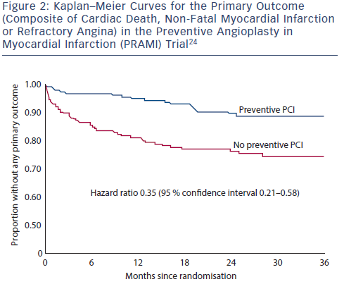
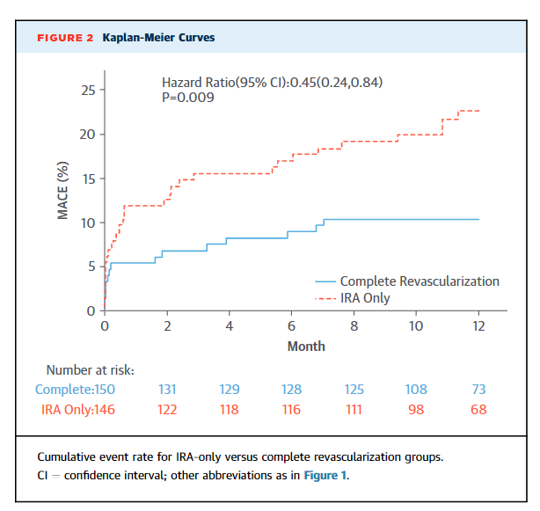
Should we treat non culprit lesions in NSTEMI ?
Data coming from STEMI trials
PRAMI trial
N = 465 patients
(100 % immediate complete revasc)
CULPRIT trial
N = 253 patients
Immediate (67%) or early staged (33%)

Slide 12
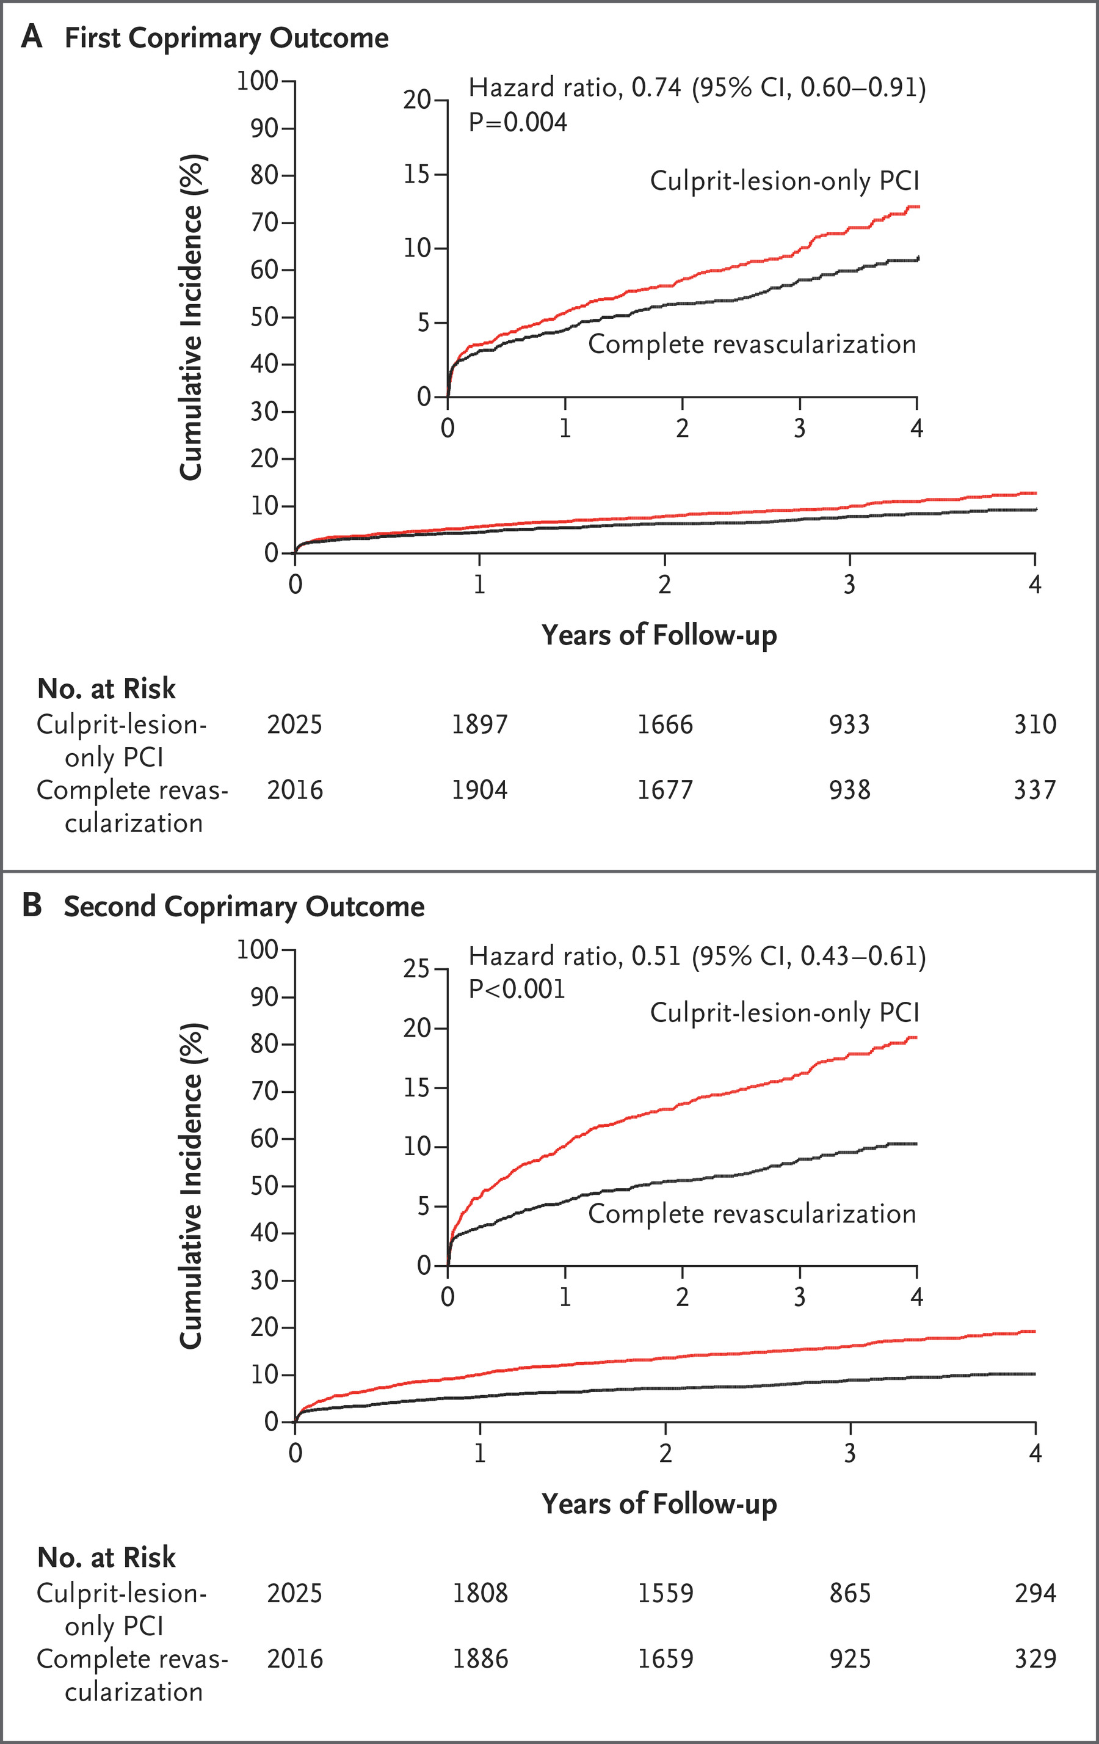
Should we treat non culprit lesions in NSTEMI ?
Data coming from STEMI trials
N=4041
Early staged (67.1%)
Late staged (32.9%)
CV Death or MI : HR 0,74 95 % 0,60 – 0,91
CL only PCI : 10,5 %
Complete revasc : 7,8 %
CV Death , MI or revasc : HR 0,51 95 % 0,43 – 0,61
CL only PCI : 16,7%
Complete revasc : 8,9 %

Slide 13
Should we treat non culprit lesions in NSTEMI ?
Can we extrapolate STEMI data from NSTEMI ?
Baseline characteristics of ACS patients in the US from 2008 to 2018
 | NSTEMI | STEMI
Age | 66 | 61
Men | 62.50% | 70.70%
Diabetes | 40% | 26.50%
Active Smoking | 28.60% | 40.20%
Hypertension | 80% | 65.70%
Atrial fibrillation | 10% | 5.20%
Stroke | 9.20% | 5%
Peripheral arterial disease | 10.90% | 5.20%
Heart failure | 16.50% | 7.30%
Cardiogenic shock | 1.60% | 7.60%
LVEF < 40 % | 20.20% | 23.60%
Sanjay, Zeitouni et al. Circ Outcomes

Slide 14
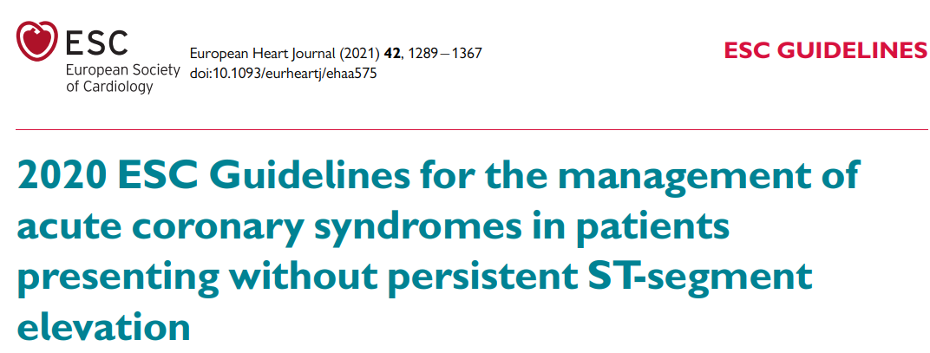
Should we treat non-culprit lesions in NSTEMI ?
Yes !
Non-culprit lesions of NSTEMI patients are future culprit lesions
Non-culprit lesions of NSTEMI patients lead to subsequent major adverse cardiac events
Complete revascularization improves outcomes (extrapolation of STEMI trials)
More research is needed

Slide 15
Should we aim for a complete revascularization in NSTEMI ?
Should we treat non-culprit lesions in NSTEMI ?
Should we be guided by coronary physiology ?
What timing for complete revascularization ?
What about NSTEMI with cardiogenic shock ?

Slide 16
Treatment of non-culprit lesions Should we use FFR in NSTEMI ?
What have we learned from STEMI trials?
Revasc guided with FFR > OMT ?
Revasc guided with FFR > Standard Revasc ?
DANAMI-3-PRIMULTI
COMPARE ACUTE trial
FLOWER-MI
FUTURE (46 % ACS)
Neutral
Maybe not ?
YES !
Subsesquent revascularzation

Slide 17
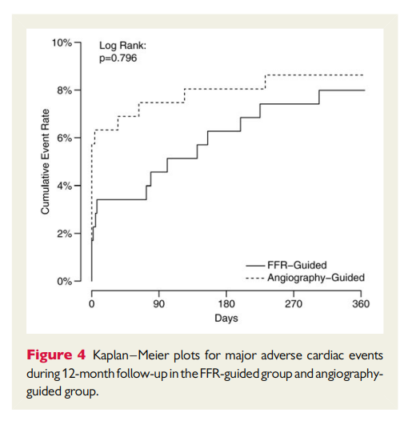
Treatment of non-culprit lesions Should we use FFR ?
No difference between both strategies
PeriMI : more frequent in standard of care
MACE in long term : more frequent with FFR

Slide 18
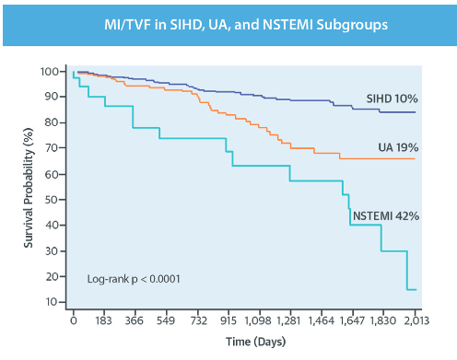
Treatment of non-culprit lesions Should we use FFR ?
What happens to obstructive non-culprit lesions with negative FFR ?
Stable CAD :
non-culprit lesion stay non-culprit
NSTEMI :
Non-culprit lesions become culprit
25 % of events at 1-year

Slide 19
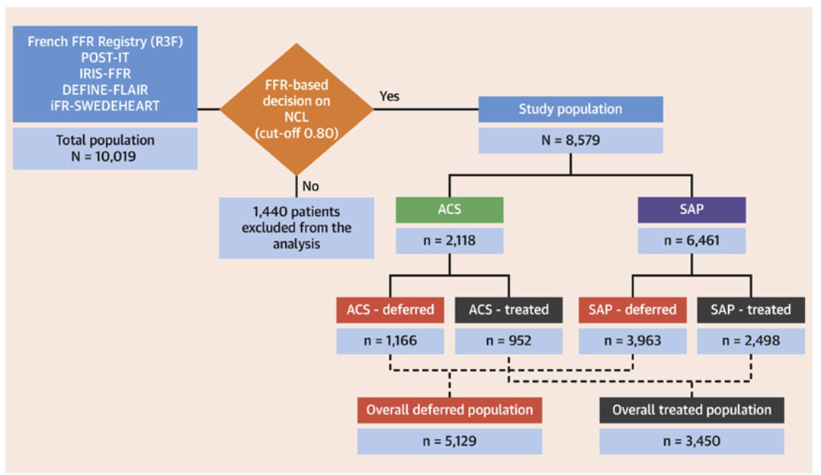
Treatment of non-culprit lesions Should we use FFR ?
What happens to obstructive non-culprit lesions with negative FFR ?
Metanalyse Cerro E et al. Revascularization Deferral of Nonculprit Stenoses on the Basis of Fractional Flow Reserve: 1-Year Outcomes of 8,579 Patients. JACC: Cardiovascular Interventions. 2020;13:1894–1903.

Slide 20
Treatment of non-culprit lesions Should we use FFR ?
What happens to obstructive non-culprit lesions with negative FFR ?
Metanalyse Cerro E et al. JACC: Cardiovascular Interventions. 2020;13:1894–1903.

Slide 21
Treatment of non-culprit lesions in NSTEMI
Should we use coronary physiology ?
Insuffisicient data to support the use of FFR in NSTEMI for lesions > 50 %
No treatment of lesions > 50 % with negative FFR could cause harm
Coronary anatomy and plaque characteristics should be used on top of FFR

Slide 22
Should we aim for a complete revascularization in NSTEMI ?
Should we treat non-culprit lesions in NSTEMI ?
Should we be guided by coronary physiology ?
What timing for complete revascularization ?
What about NSTEMI with cardiogenic shock ?

Slide 23
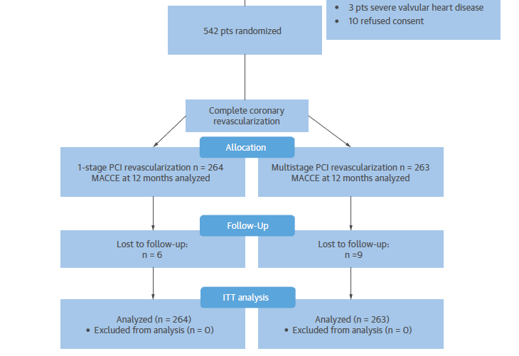
Treatment of non-culprit lesions One stage or multi-stage ?

Slide 24
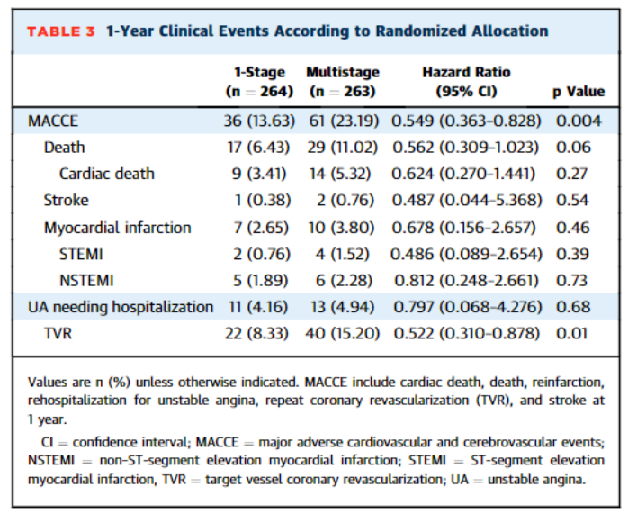
Treatment of non-culprit lesions One stage or multi-stage ?
Immediate strategy was superior to multi-stage strategy to reduce MACE
Results driven by a reduction of target vessel revascularisation
Less myocardial damage with a one stage procedure

Slide 25
Treatment of non-culprit lesions One stage or multi-stage ?
Possible and feasible
Interesting in case of uncertainty regarding the culprit lesion
Adapt to the patient’s profile and lesions’ characteristics (complex PCI / CTO)
Don’t forget about the Heart Team and possibility of CABG
More Research is needed

Slide 26
Should we aim for a complete revascularization in NSTEMI ?
Should we treat non-culprit lesions in NSTEMI ?
Should we be guided by coronary physiology ?
What timing for complete revascularization ?
What about NSTEMI with cardiogenic shock ?

Slide 27
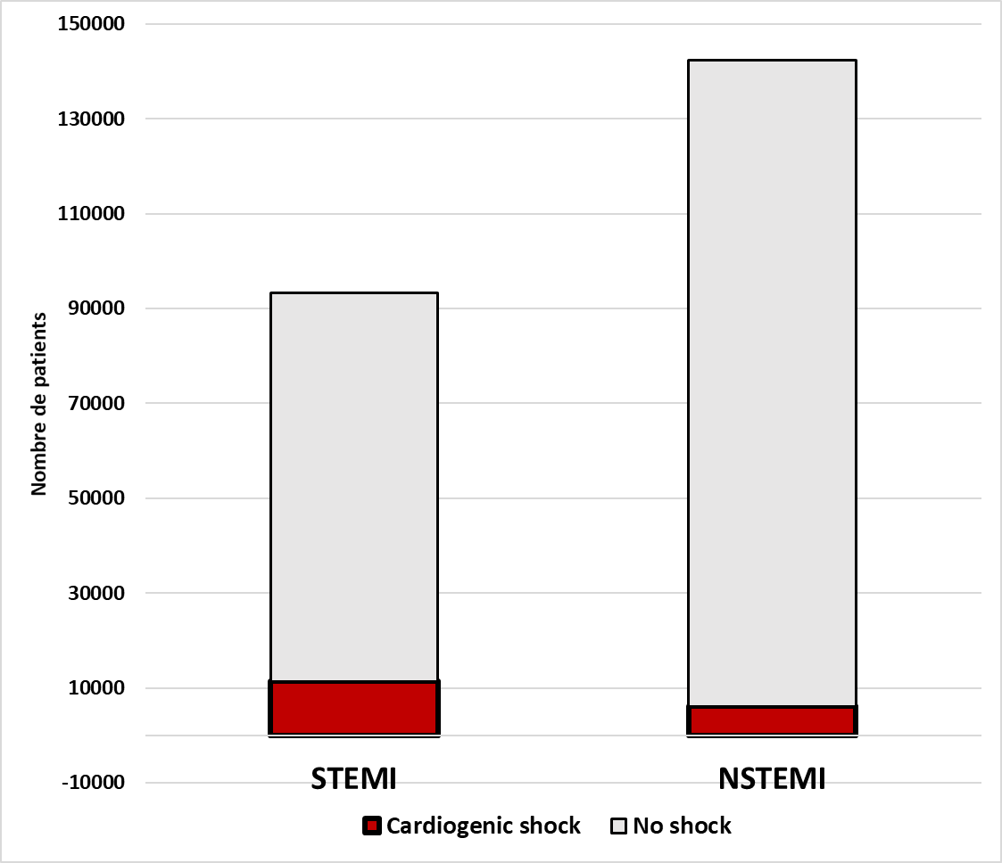
Treatment of non-culprit lesions in NSTEMI & Cardiogenic shock
Admissions for ACS in the USA from 2007 to 2011
Anderson ML et al. Circulation: Cardiovascular Quality and Outcomes. 2013;6:708–715.
12 %
4 %

Slide 28
Multivessel coronary lesions in patients with cardiogenic shock and acute MI
Treatment of non-culprit lesions in NSTEMI & Cardiogenic shock

Slide 29
Treatment of non-culprit lesions in NSTEMI & Cardiogenic shock
Answers from the CULPRIT-Shock trial
706 randomized patients
686 patients with full informed consent
665 (92.1%) patients with available ECG classification
STEMI
N=372, (55.9%)
NSTEMI
N= 195, (29.3%)
LBBB-MI
N=98, 14,7%
Zeitouni M, Thiele H, Montalescot G et al. Chest, 2020

Slide 30
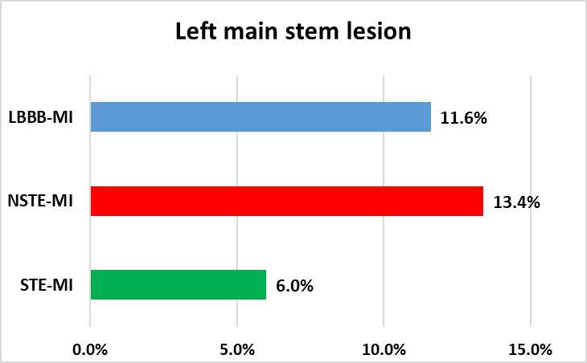
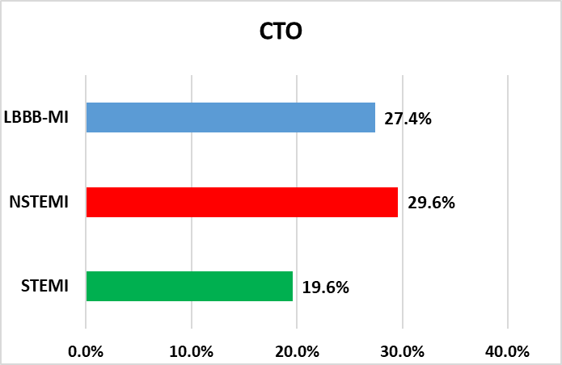
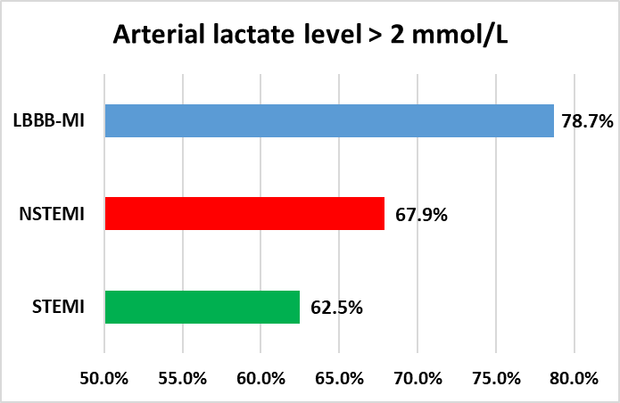
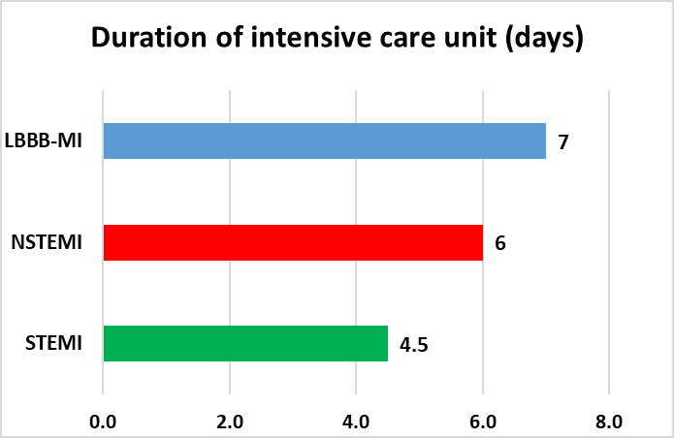
Treatment of non-culprit lesions in NSTEMI & Cardiogenic shock
Answers from the CULPRIT-Shock trial
Zeitouni M, Thiele H, Montalescot G et al. Chest, 2020

Slide 31
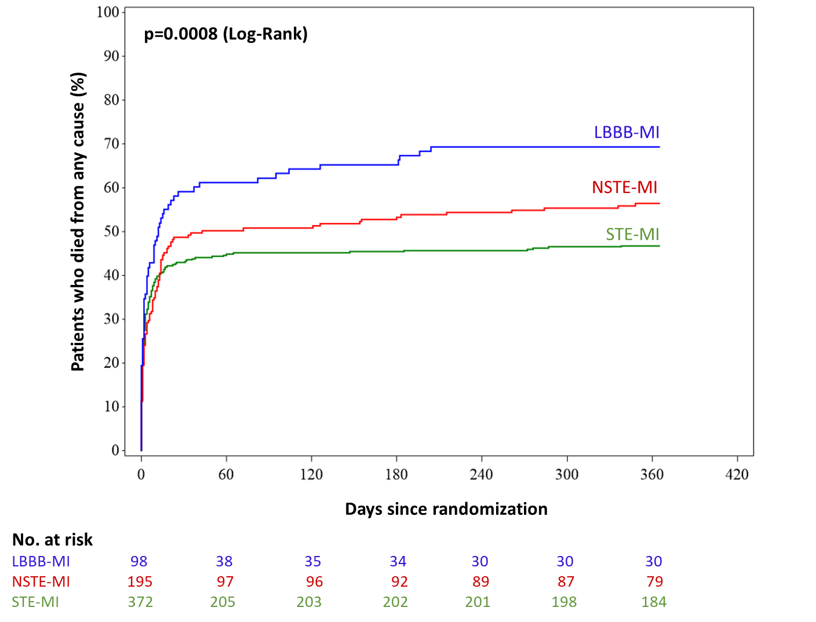
Treatment of non-culprit lesions in NSTEMI & Cardiogenic shock
Answers from the CULPRIT-Shock trial
NSTEMI vs. STEMI
absolute difference of 13 %
OR 1.47, 95%CI [1.04 – 2.09]]
69.4%
56.4%
46.8%
LBBB-MI vs. STEMI absolute difference of 23 %
OR 2.58, 95% CI [1.60 – 4.15]
Zeitouni M, Thiele H, Montalescot G et al. Chest, 2020

Slide 32
Treatment of non-culprit lesions in NSTEMI & Cardiogenic shock
Answers from the CULPRIT-Shock trial
Effect of revascularization strategy according to ECG presentation
Zeitouni M, Thiele H, Montalescot G et al. Chest, 2020

Slide 33
Treatment of non-culprit lesions in NSTEMI & Cardiogenic shock
Answers from the CULRPIT-Shock trial
We shall not immediately treat culprit-lesions in NSTEMI with cardiogenic showk

Slide 34
Should we aim for a complete revascularization in NSTEMI ?
Should we treat non-culprit lesions in NSTEMI ? Probably yes ! Aim for complete revascularization
Should we be guided by coronary physiology ? Probably not…or in addition to intra-coronary imaging ?
What timing for complete revascularization ? One-stage or multiple-stage…but don’t forget about the heart team!
What about NSTEMI with cardiogenic shock ? Culprit-lesion only !

Slide 35
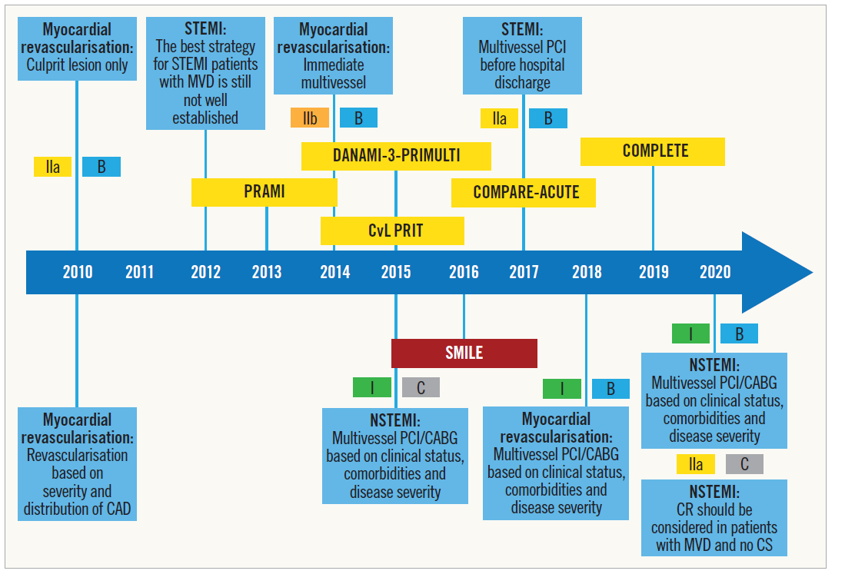
More research is needed in NSTEMI !

Slide 36
Thank you !
Présentation disponible sur www.action-coeur.org
Suivez nous sur :
Twitter @ActionCoeur
Facebook facebook.com/actioncoeur
Linked-in www.linkedin.com/action-coeur/

Slide 37
Thank you !

