Slide 1

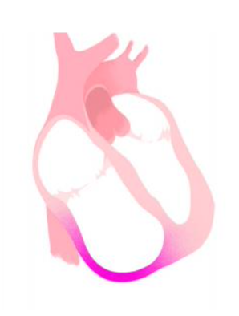
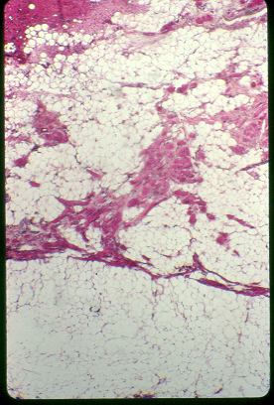


Cardiomyopathie arythmogène: physiopathologie
Pr Estelle GANDJBAKHCH
Hôpital Pitié Salpêtrière, fondation ICAN
Centre de référence des maladies cardiaques héréditaires

Slide 2
Disclosures
Consulting fees from Microport, Medtronic

Slide 3
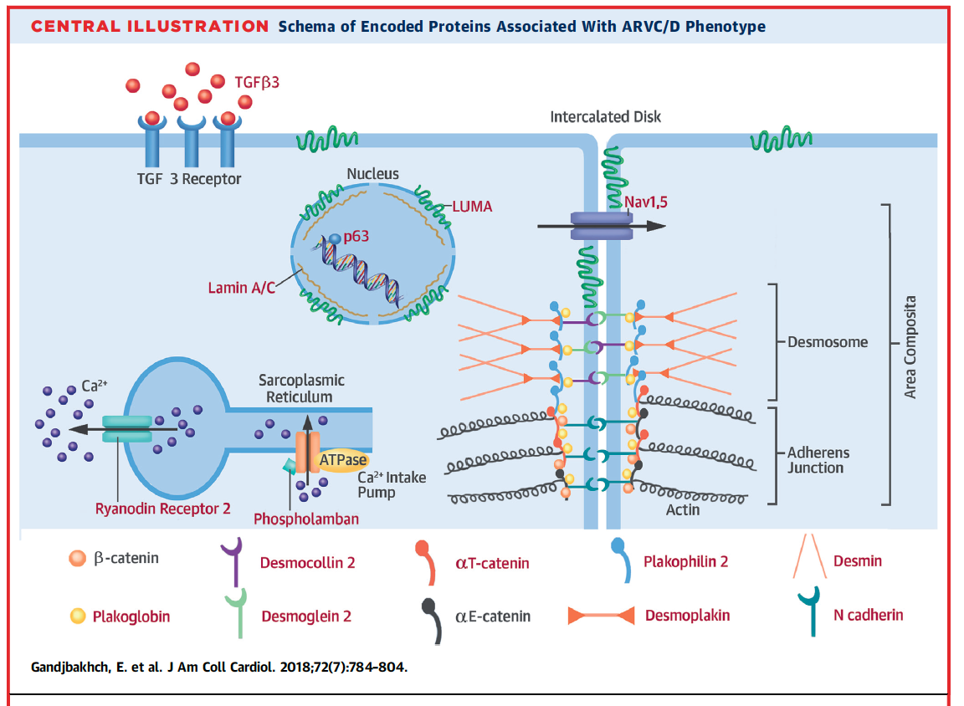
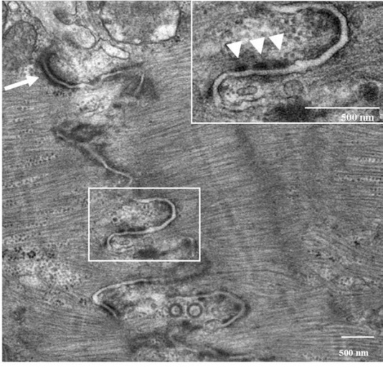
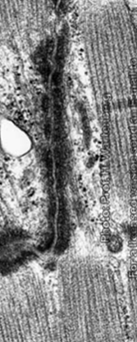
ARVC is a inherited cardiomyopathy
Desmosomal genes +++
Biopsy
Basso et al., EHJ , 2006

Slide 4
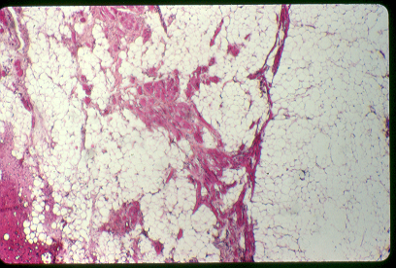
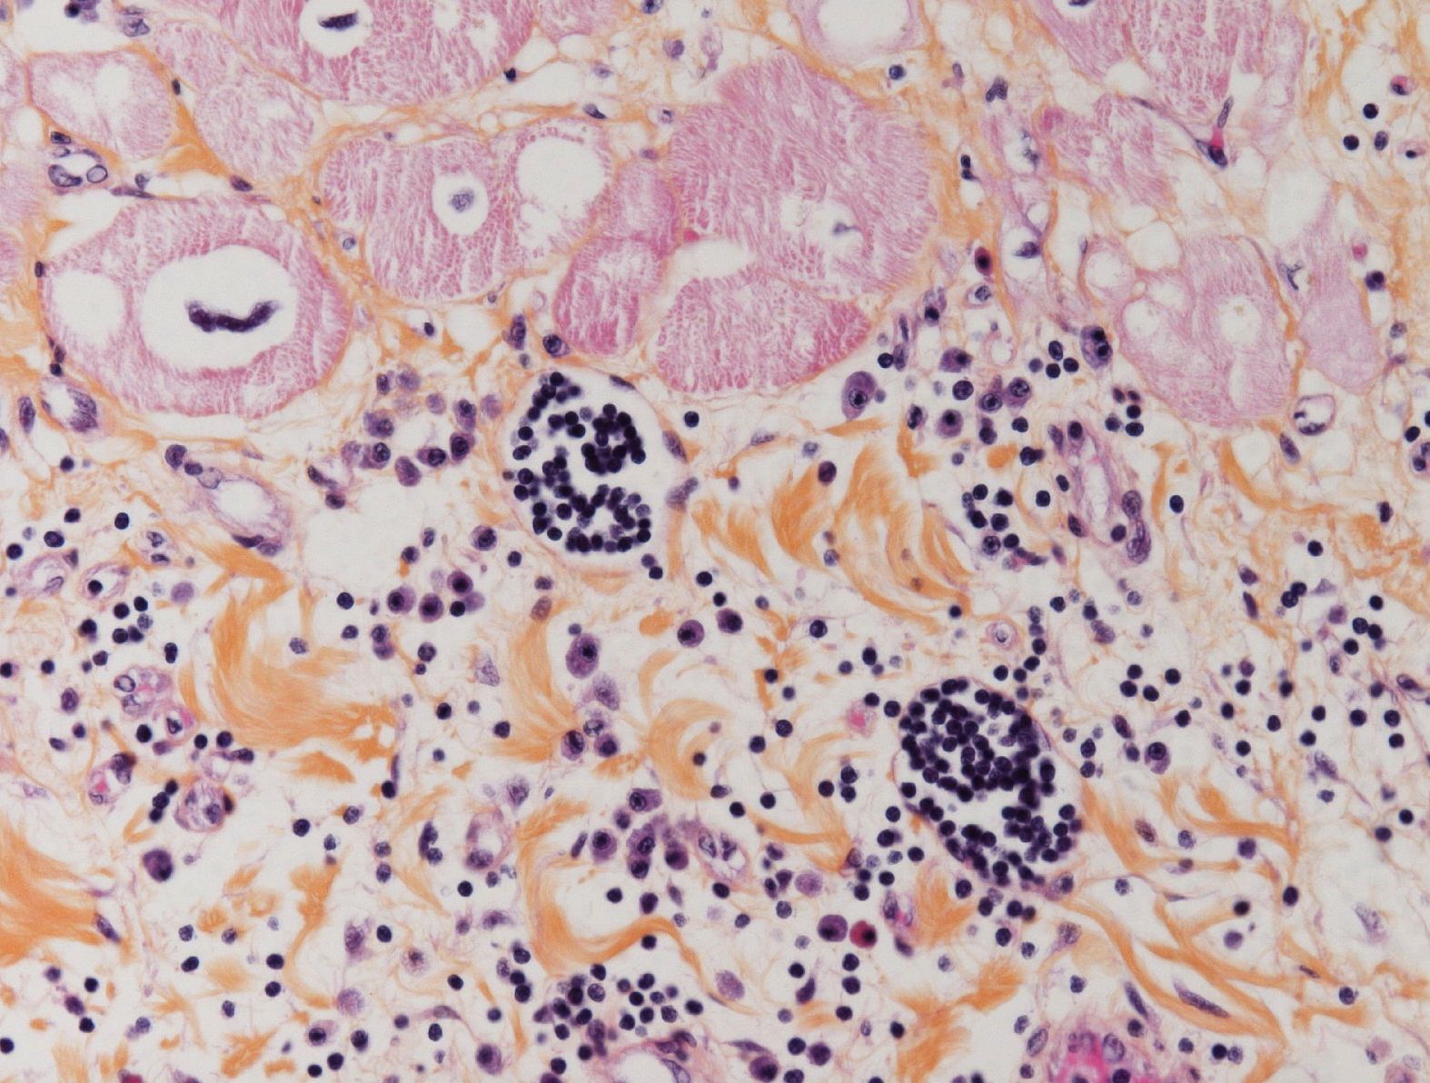
Anatomopathological findings
Contrôle
DVDA
Genetic pathogenic variant
Desmosome ++
1. Apoptosis
Fibrofatty scar
Nishikawa, Cardiovasc Path, 1999
2. Inflammation
Inflammatory infiltrates
3. Adipogenesis/fibrogenesis
Reentrant VT
Ventricular dysfunction
4. Electrical Remodelling

Slide 5
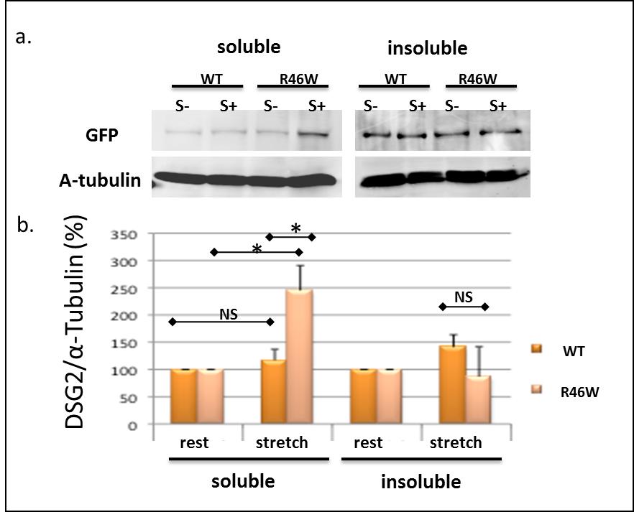
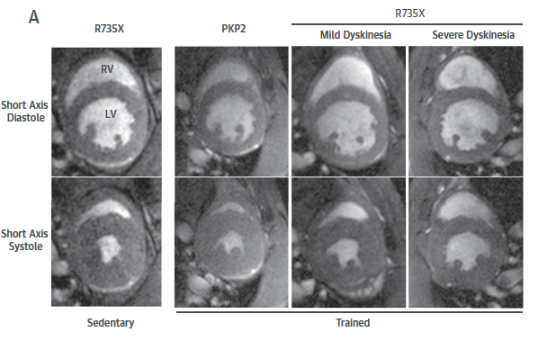
Exercise and ARVC : animal and in vitro data
Cruz et al, PNAS, 2015
Vite A, Gandjbakhch E et al, Europace 2019

Slide 6
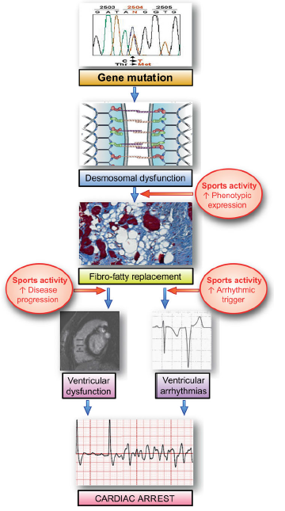
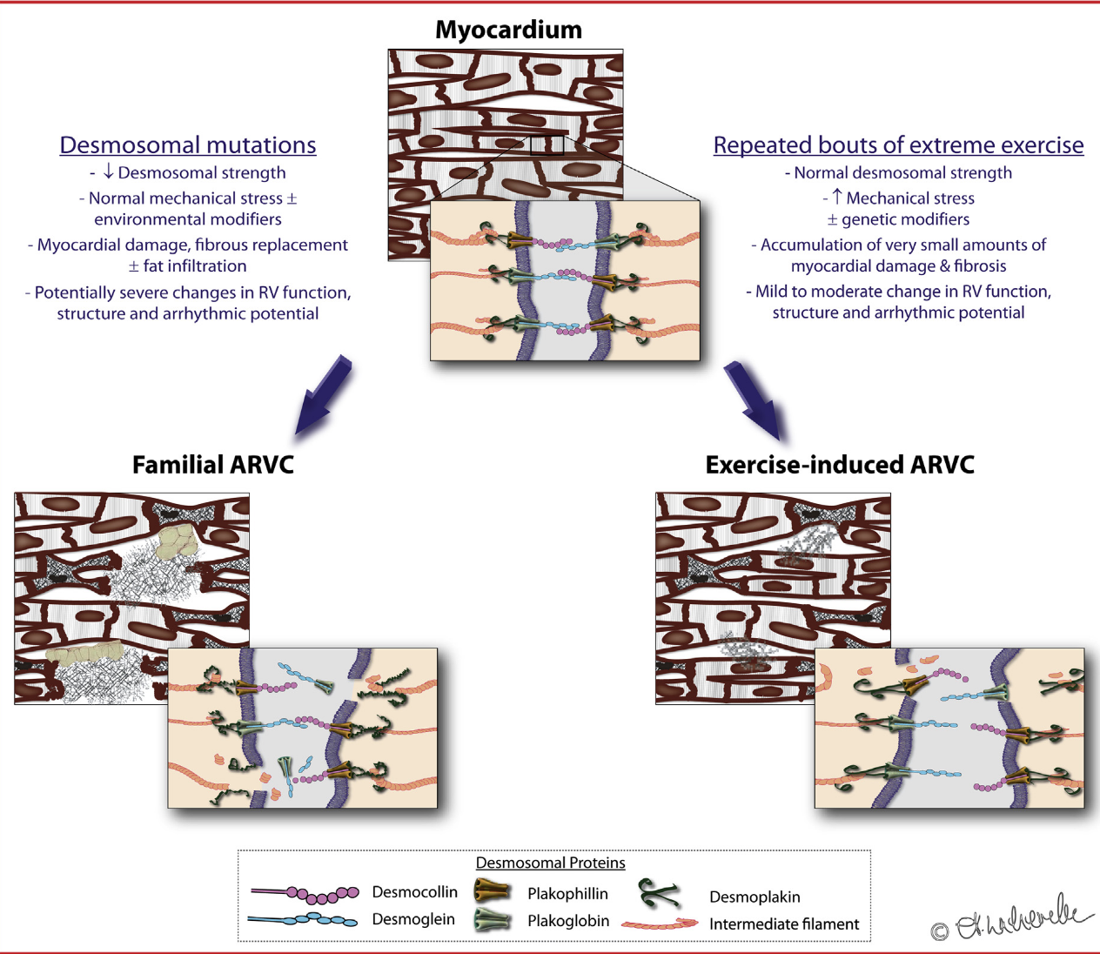
Exercice and ARVC
Prior and La Gerche et al., Heart, Lung and Circ, 2020
La Gerche et al, Med Sci Sports Exerc2011
Corrado et al., EHJ, 2015

Slide 7
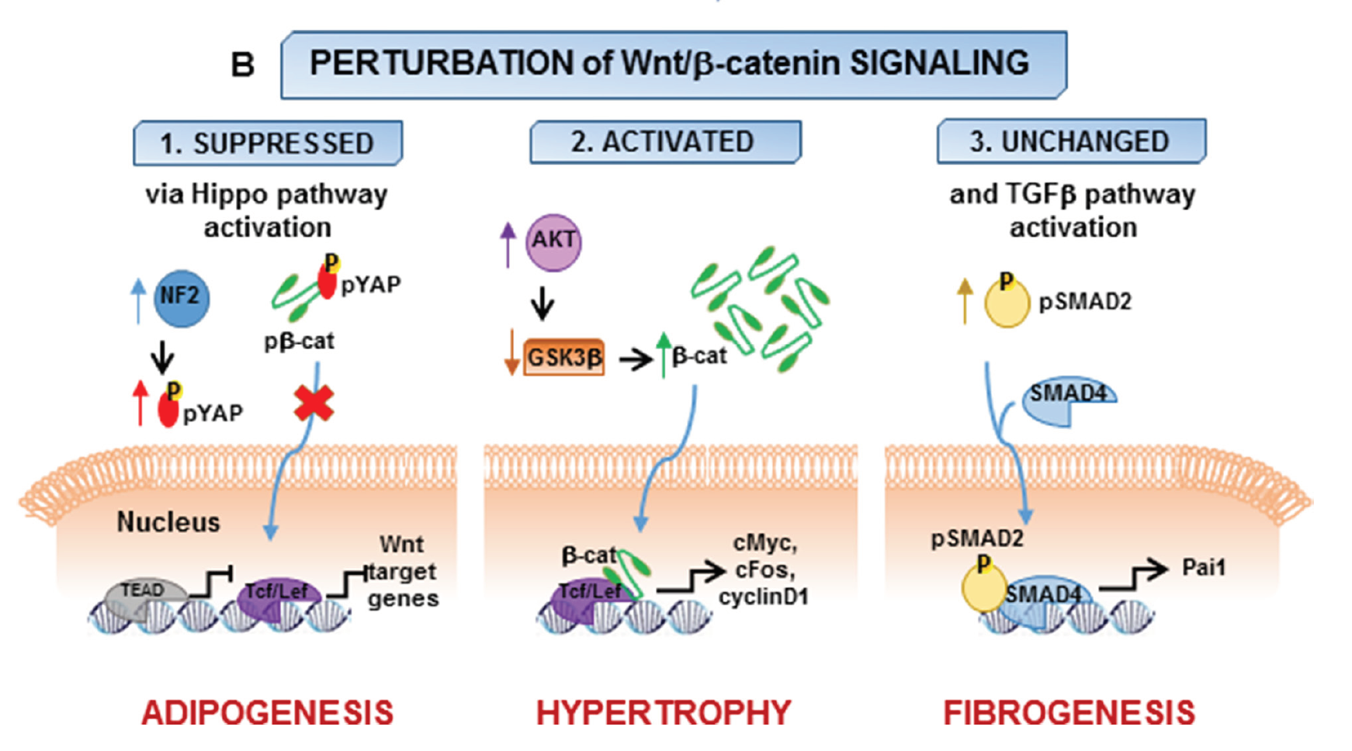
Fibrogenesis/adipogenesis
Wnt/beta catenin pathway
Epicardial progenitors differentiation
Lorenzon et al., Oncotarget, 2017

Slide 8
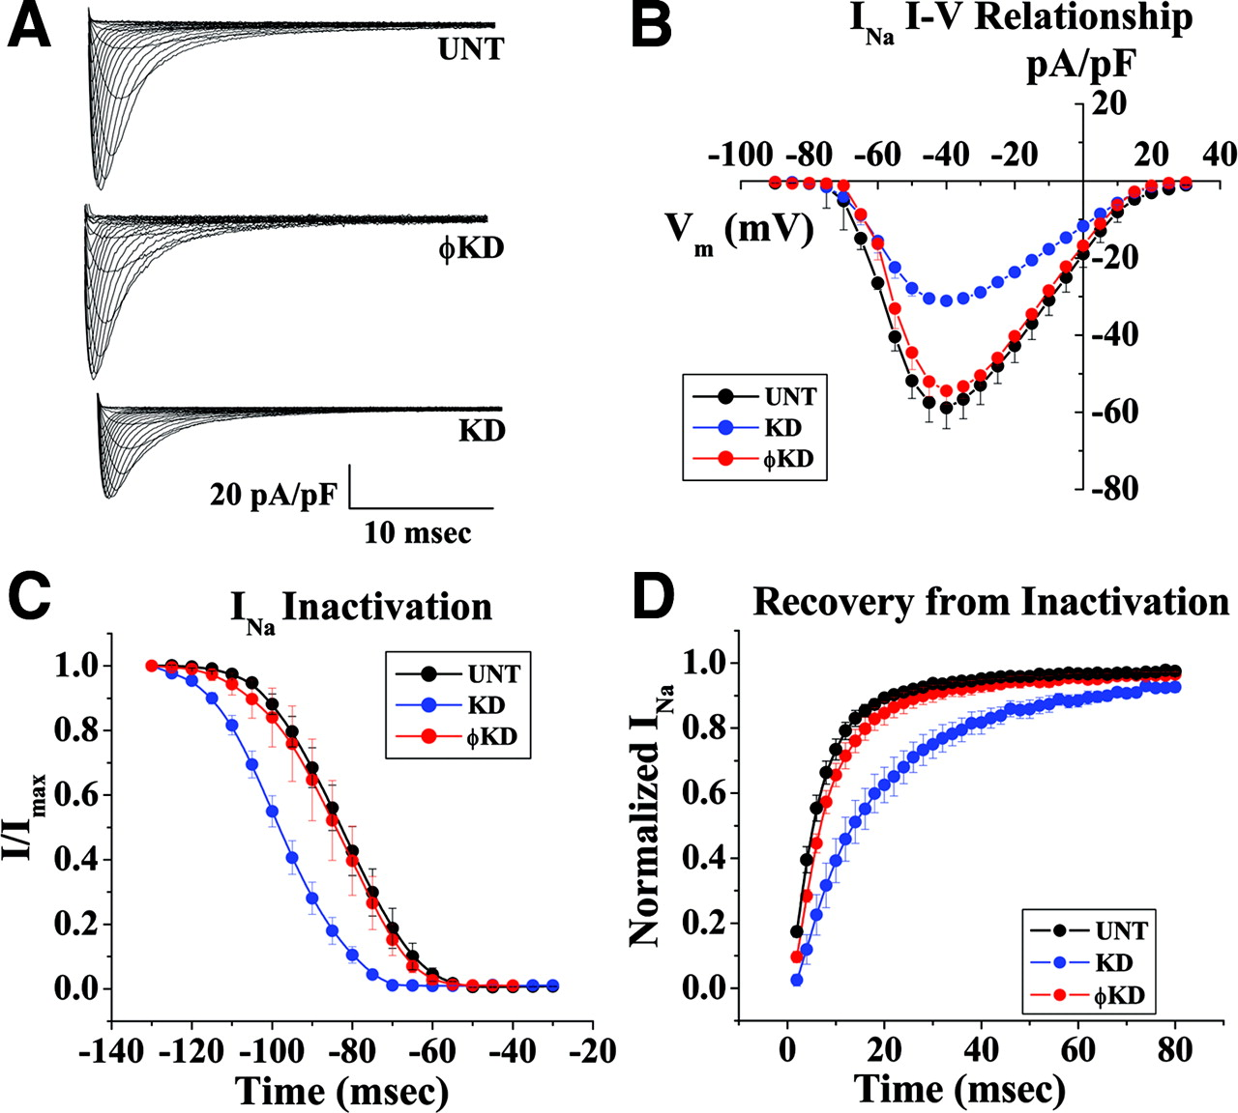
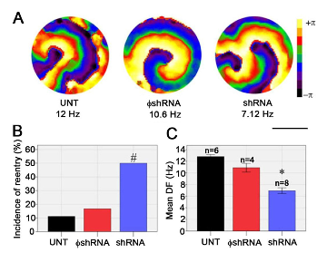
Electrical molecular remodeling
Voltage clamp data from adult cardiomyocytes after PKP2 knockdown (KD)
Control
ARVC
Connexin 43
Oxford et al., Circ Res, 2007
Fidler et al. J Cell Mol Med, 2008
Sato, P. Y. et al. Circ Res 2009;105:523-526
Deo et al., Heart Rhythm, 2011

Slide 9
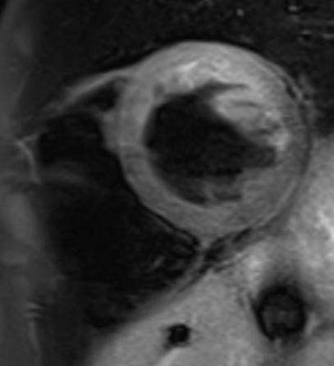
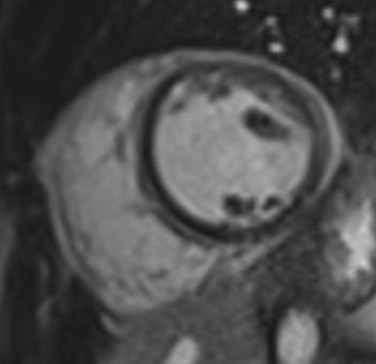
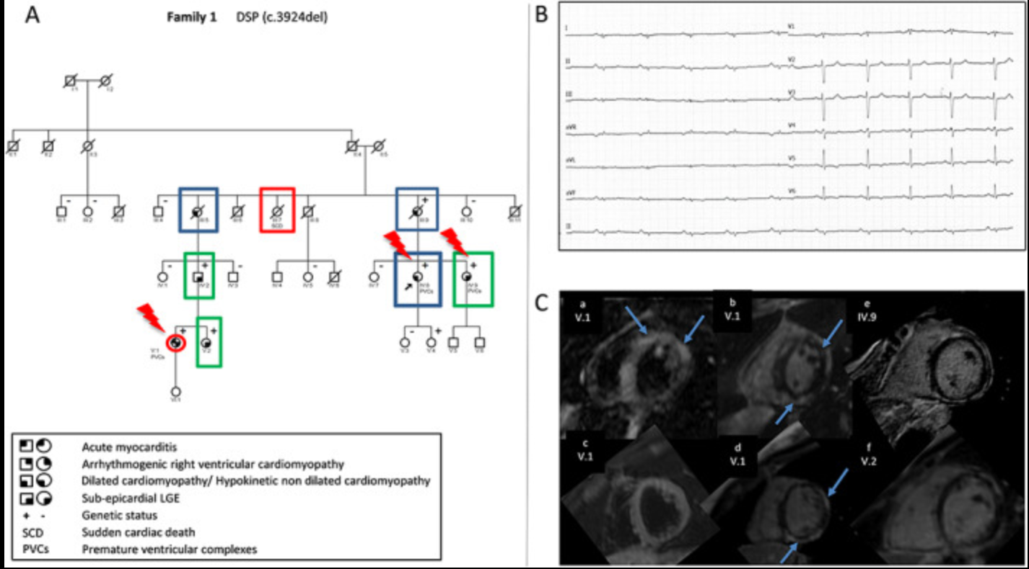
Role of inflammation?
Case series of 16 patients with acute myocarditis associated with VA or RV abnormalities → pathogenic variant found in 56%
PKP2 (n=5), DSP, DGS2, DES, RYR2+ DTNA
Ader et al. Circulation: Genomic and Precision Medicine 2020
25 yo women
Several « myocarditis » episodes
DSP mutation
Hyper T2
Diffuse Epicardial LGE
Among 560 ACM probands and family members: 23 (4%) presented with a hot phase, often at a pediatric age
Bariani et al. Europace 2021
Piriou et al. ESC heart Fail 2020

Slide 10
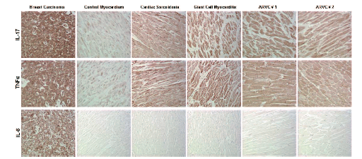
Mechanisms?
Role of viruses?
Identification of cardiotrope viruses but their role remains unknown…
Lymphocyte infiltrates (T8)
Sometimes Neutrophils
Autoimmunity?
Identification of antiDSG2 and anti junction antibodies in ARVC patients
Asimaki et al. Circ Arrhythm Electrophysiol. 2011

Slide 11
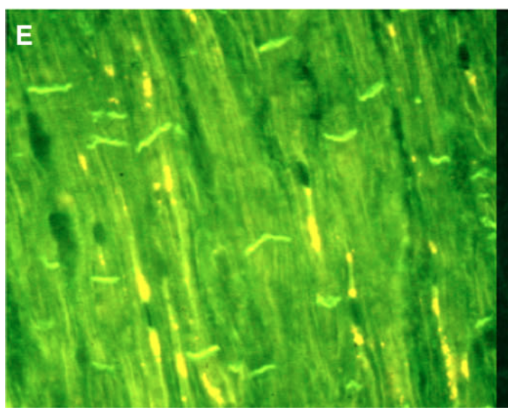
Autoimmunity
Anti DSG2 antibodies
Anti-heart autoantibody and anti-intercalated disk autoantibody
 | ARVC probands | ARVC affected relatives | ARVC healthy relatives | DCM | iCM | Healthy controls
AHA | 37% | 38% | 25% | 4% | 1% | 2.5%
AIDA | 8% | 21% | 15% | 4% | 2% | 0,4%
Chatterjee et al. EHJ 2018
Caforio et al. Circulation 2020

Slide 12
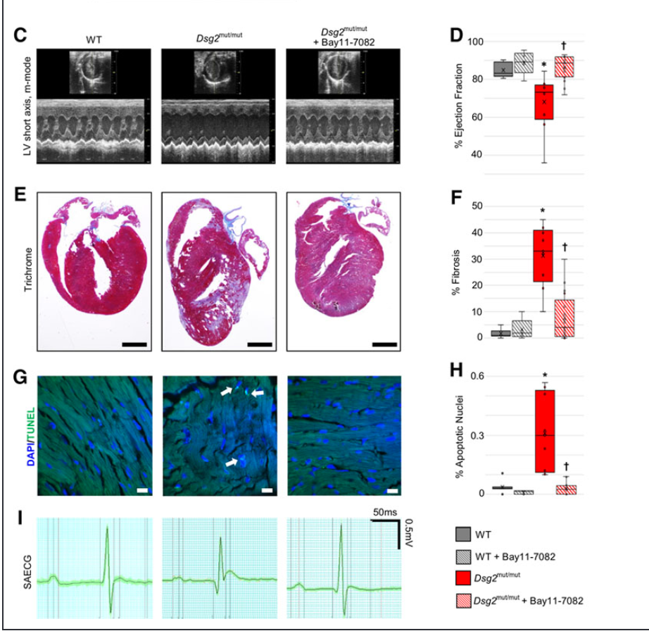
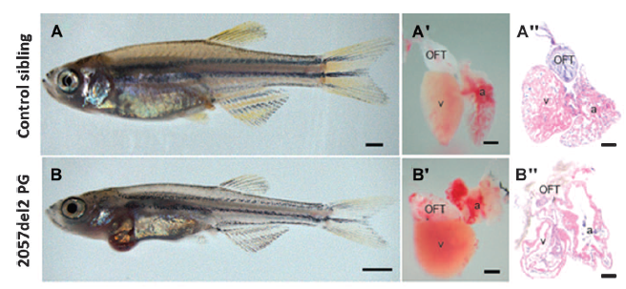
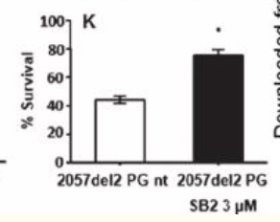
GSK3β and NFkB inhibitors
Asimaki et al. Sci Transl Med 2014
Chelko et al. Circulation 2019

Slide 13
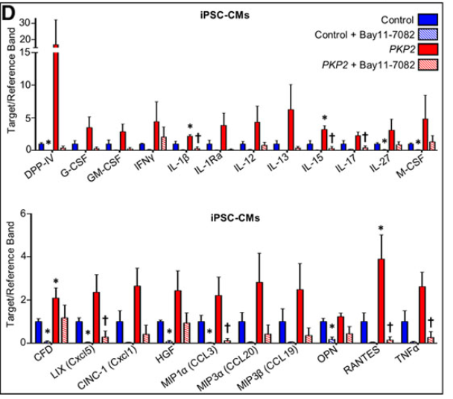
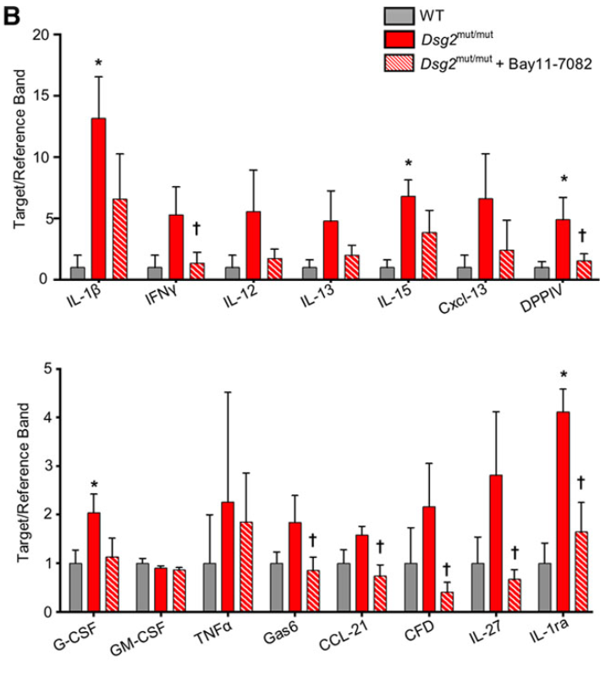
NFkB inhibitors and inflammatory response
IPS-CM PKP2 + patient
Animal model DSG2 mut mice
Chelko et al. Circulation 2019

Slide 14
Key messages
Genetic pathogenic variant
Desmosome ++
GSK3b
Wnt/beta-catenin pathway
Exercice
apoptosis
Fibrogenesis/
adipogenesis
NFkB pathway
Progenitors differenciation
Inflammation
Cx 43
Ion channel remodelling
Auto immunity
Exercice
Reentrant VT
Ventricular dysfunction

