Slide 1


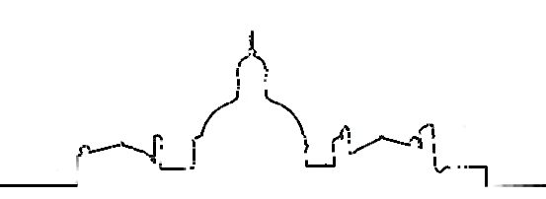




State-of-the art Triage of patients with suspected ACS
Gilles Montalescot
Dr. Montalescot reports research Grants to the Institution or Consulting/Lecture Fees from Abbott, Amgen, AstraZeneca, Bayer, Boehringer Ingelheim, Boston Scientific, Bristol-Myers Squibb, CellProthera, CSL Behring, Europa, Idorsia, Servier, Medtronic, MSD, Novartis, Pfizer, Quantum Genomics, Sanofi-Aventis.
03
Nos logos
You can simply impress your audience and add a unique zing and appeal to your Presentations.
action-groupe.org
Paris, France

Slide 2

Earlier is Better

Slide 3

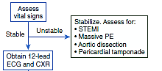
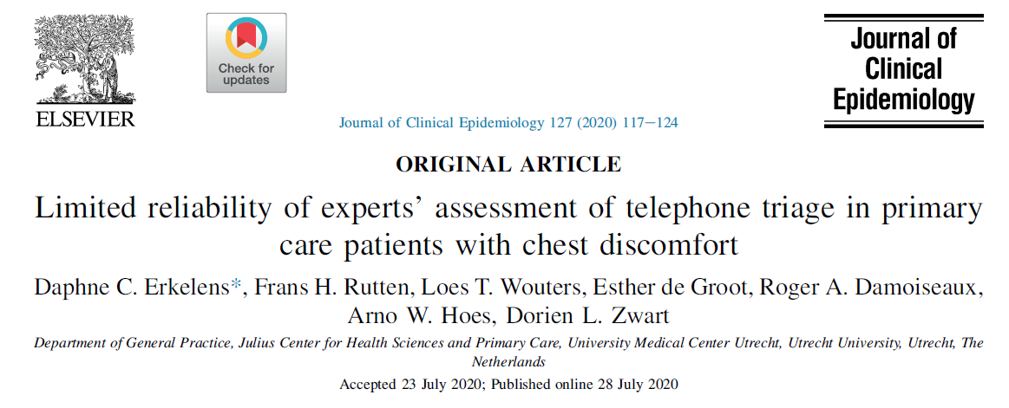
triage of « Chest Symptom »
(distant diagnosis)
Life threats
Cardiac arrest
Shock
Aortic dissection
Massive PE
Tamponnade
STEMI
Pneumothorax/Pneumonia
No life threats but highly suspicious
1-7% of
missed ACS
ECG
Markers
Imaging
Emergency dismissed
Primary care
OK

Slide 4

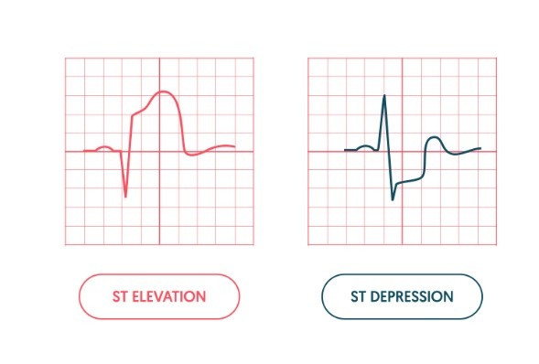
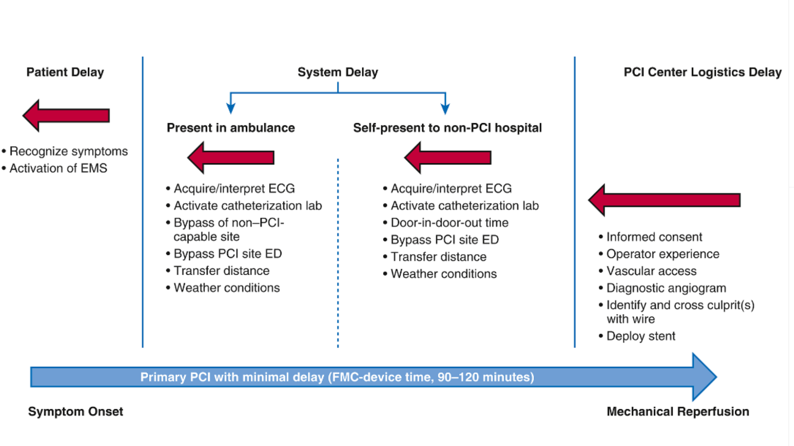
triage of « ST-elevation »
(1st contact diagnosis)

Slide 5

triage of « non ST-elevation »
(on-site diagnosis)

Slide 6
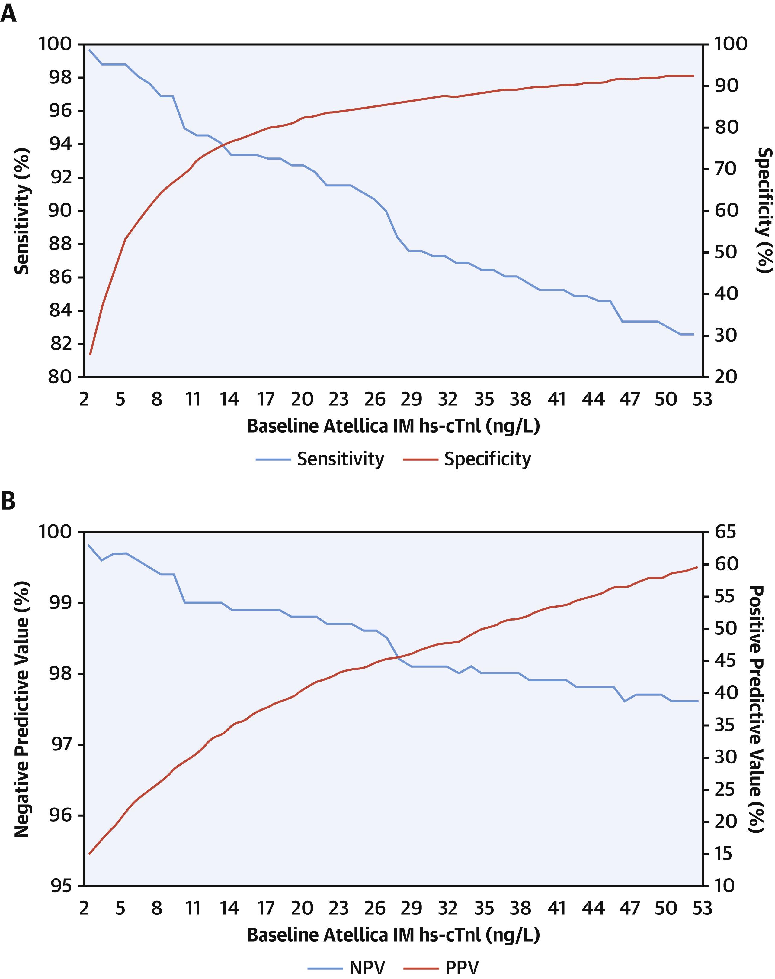
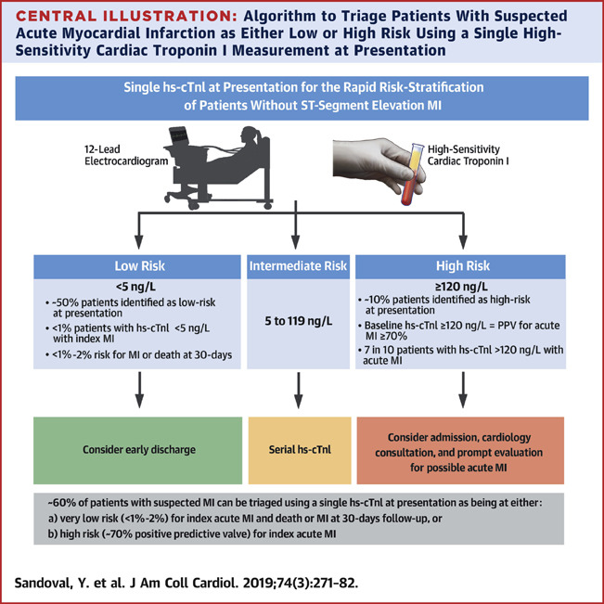
Triage with single Hs TnI → pre-hospital POC?
Notes:
Late presenters
noprioriIHD

Slide 7

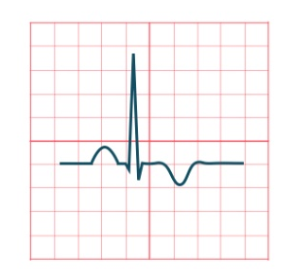
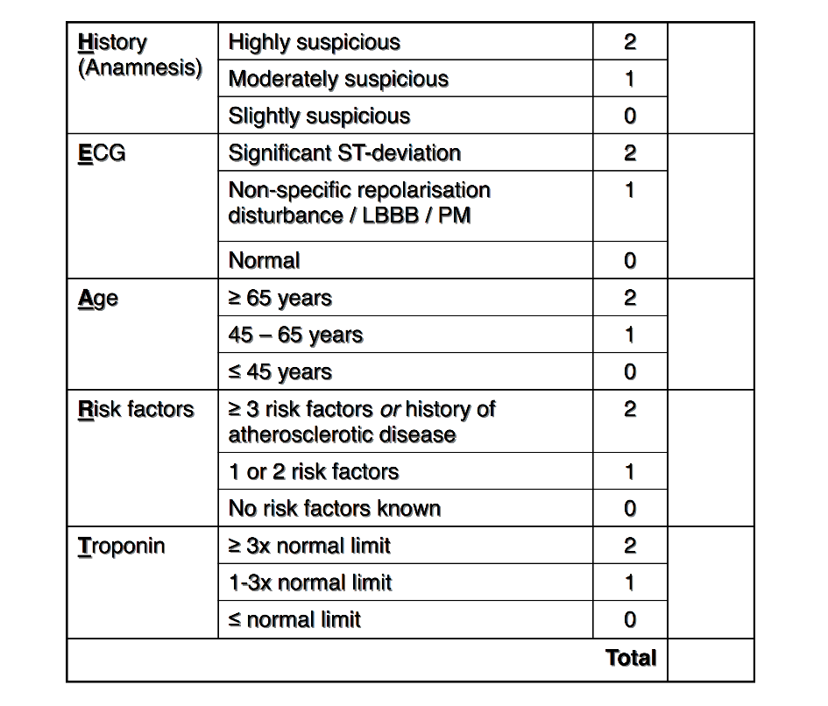
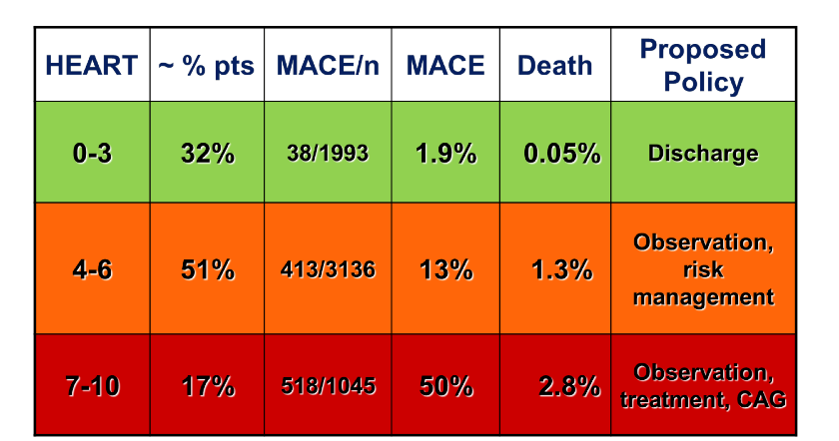
triage → scores
(pre-hospital diagnosis)
HEART score
3.3% of patients with MACE are ‘missed’ by the HEART score in a meta-analysis
HEART score depends much on Tn test and protocol
MACE 7.7% in the ESC 0/1-hour algorithm vs 1.1% in the HEART score “low-risk” patients (p<0.001)
P. Van den Berg et al. EHJ-ACC 2018
M. Cortes et al. EHJ-ACC 2020

Slide 8
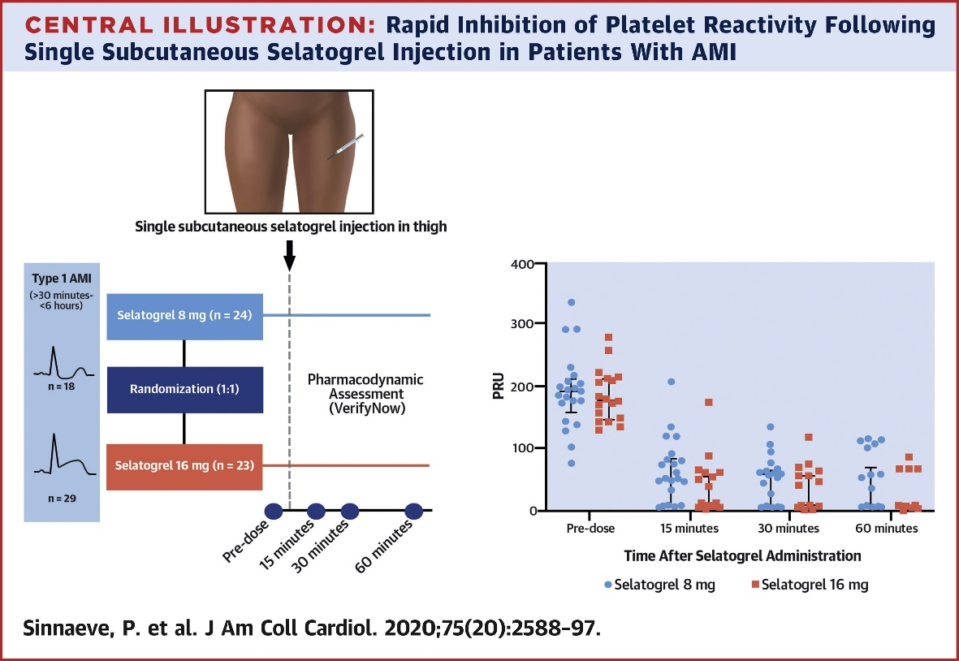

Earlier than first medical contact
(self diagnosis)
Hulot JS and Montalescot G. Eur Heart J 2019

Slide 9

Accurate is Better

Slide 10
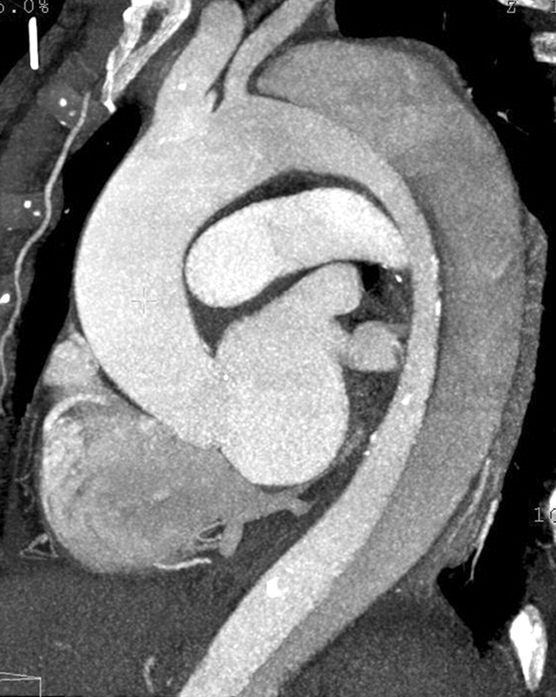
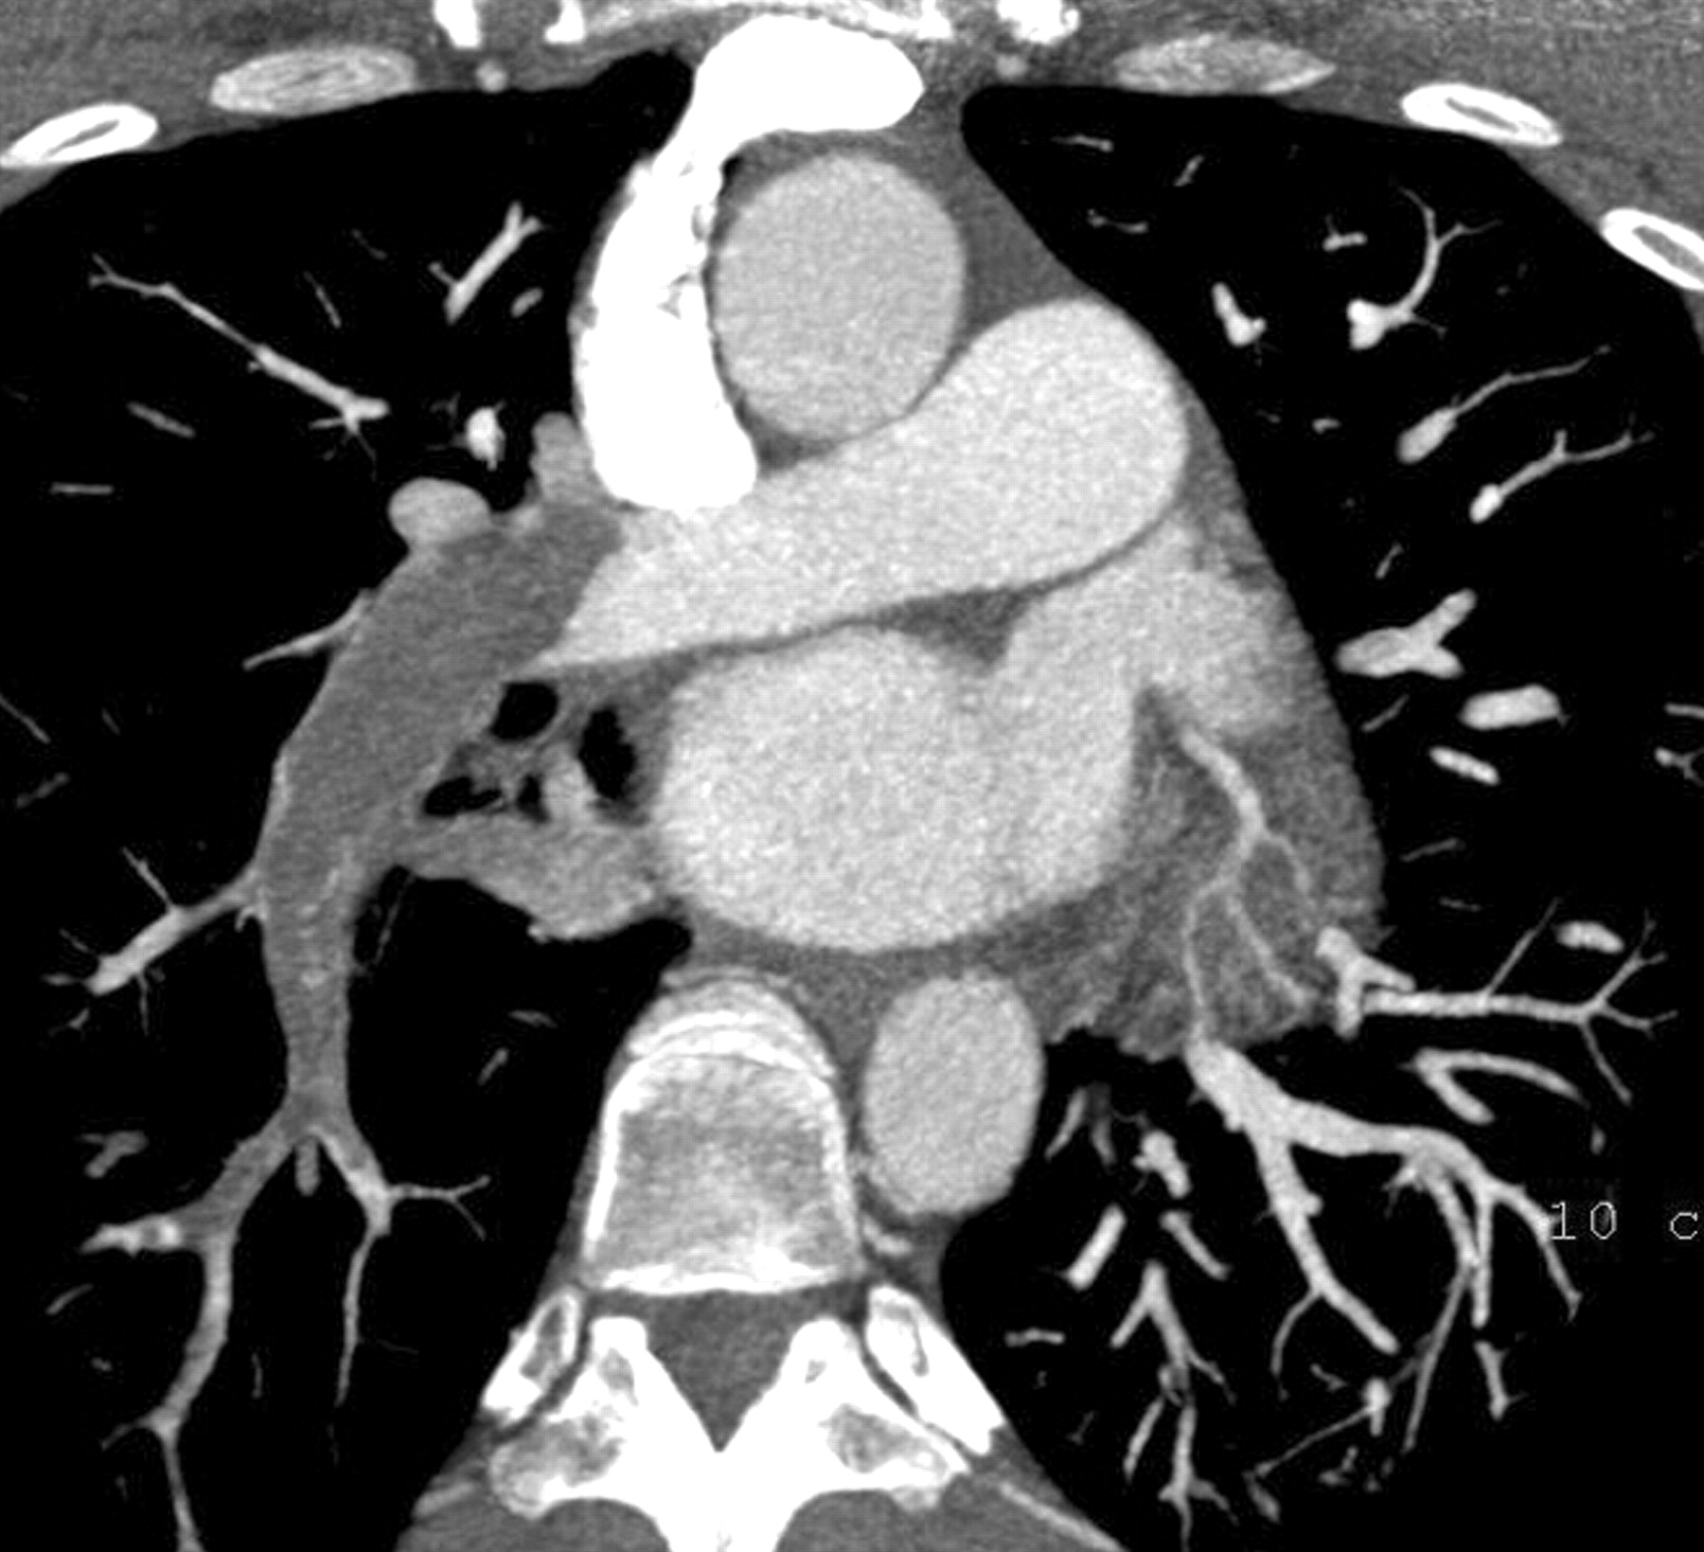
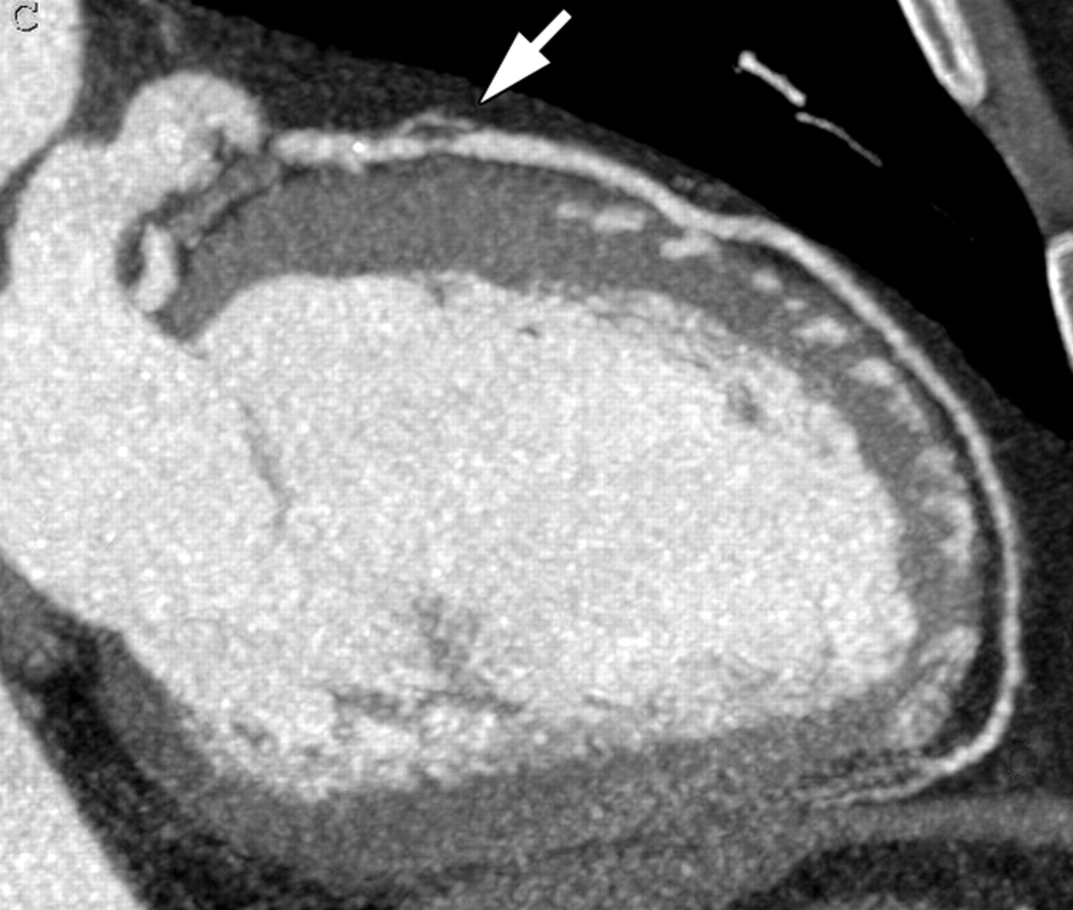
Non-conclusive → Triple RO CT
Halpern EJ. RSNA. https://doi.org/10.1148/radiol.2522082335

Slide 11






Alternative options
Acute heart failure
Pericarditis
Acute anemia
Myocarditis
TakoTsubo
LVH
Cardiomyopathy
Myocardial ischemia
Pulmonary Embolism
Aortic dissection
Pneumothorax
Pneumonia
Pancreatitis
…
Chest-X ray
D-Dimers, BNP, Hb
TTE, TEE
MRI
Stress test/imaging
Catheterization

Slide 12








Place of diagnosis
Dispatch center
MICU
Paramedics
ER doctors
CP unit/CCU
Specialized nurses
Cardiologists

Slide 13






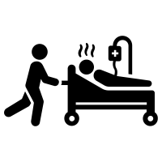




Place of diagnosis

Slide 14


Conclusions
01
Time of diagnosis is essential for life-threatening situations
02
Place of diagnosis is important for atypical presentations
03
Senior expertise needs to be available

Slide 15
Thank you!
www.action-groupe.org

