Slide 1


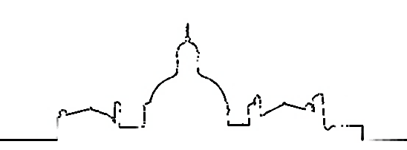




The ENVISAGE-TAVI trial
Jean-Philippe Collet for the ACTION group
03
Nos logos
You can simply impress your audience and add a unique zing and appeal to your Presentations.
Dr. Collet reports research Grants to the Institution or Consulting/Lecture Fees from Abbott, AstraZeneca, Boston Scientific, Bristol-Myers Squibb, Medtronic, Pfizer.
action-groupe.org
Paris, France
Notes:
- slide 14 : dans ENVISAGE ils font toutes leurs analyses sur APT declaré avant rando (48%) alors que en faitil y a apres rando 60% des patients sous APT.
-Pour DAPT j’ai trouvé 1.8% ATLANTIS et 13% ENVISAGE pour ces patients sous antico
-Slide 15 : primary safety c’est 3.4.5 pour atlantis // c’est ISTH pour ENVISAGE
-Slide 15 : valve thombosis ils rapportent 0 dans chaque groupe en fait !!! le truc impossible a moins de ne pas les chercher
-Slide 16 ; « Justification of a composite outcome in a non-inferiority trial “ composite EP n’est pas un pb ; le pb c’est le NCB le pb !
-conclusions : la preiere ligen est ironique biensur // la deuxieme : il y repond dans sa conclusion et c’est pas grand monded : les sans antiplaq et avec demi-dose (tu ne parles pas du totu de la difference de resultat selon les doses (on a l’impresson qu’ils sont surdosés a 60)// je ne sai s pas si on peut dire sur cette presentaitn que NOACs are not all the same after TAVI

Slide 2
Background
AF patients → 1/3 of the TAVI population → Higher risk of events
A substantial proportion are exposed to NOAC prior to TAVI
New-onset of AF → 10%

Slide 3
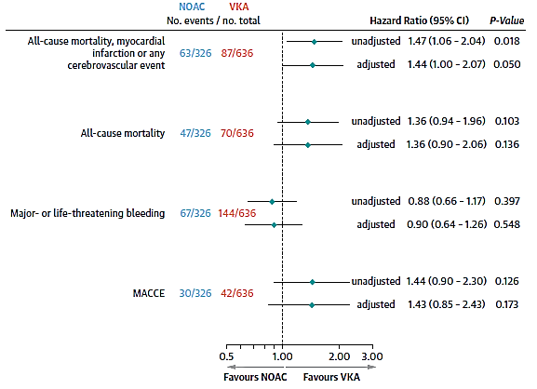
Registries (TAVI with indication for OAC)
→
Jochheim D, et al. JACC Intv 2019;12:1566–1576

Slide 4
Recommendations
ATLANTIS; ENVISAGE ?
Adapted from Otto CM, et al. J Am Coll Cardiol 2021;77:e25–197.

Slide 5
Randomized trials with NOAC
(in place of warfarin)

Slide 6
ATLANTIS
N = 451

Slide 7
ATLANTIS (indication for anticoagulation stratum)
1° Endpoint (Net Clinical Benefit)
1° Safety Endpoint (BARC 3, 4 or 5)
Obstructive valve thrombosis: n=2 (apixaban) vs n=3 (VKA)
Collet JP, Montalescot G, et al ACC 2021
Notes:
35% had the low dose.

Slide 8
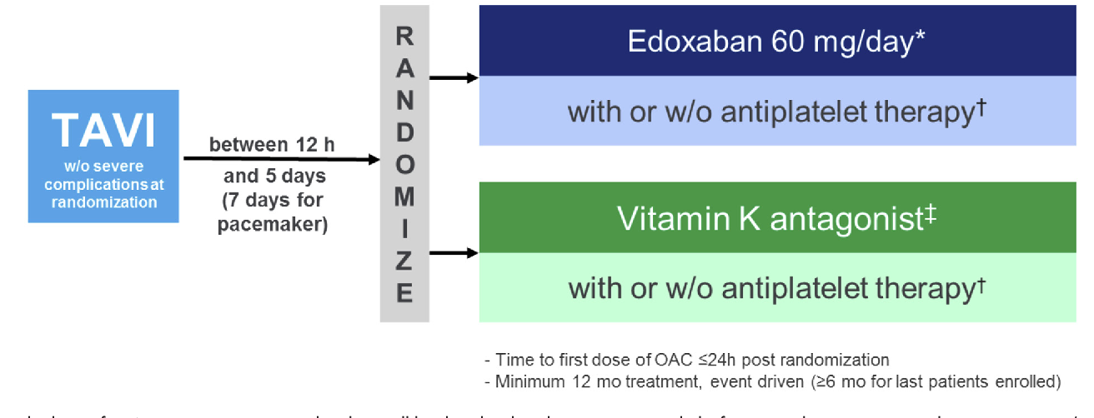
ENVISAGE-TAVI AF
1° EP (NCB) : all-cause death, MI, stroke, systemic thromboembolism, valve thrombosis, major bleeding.
1° safety EP : major bleeding

Slide 9
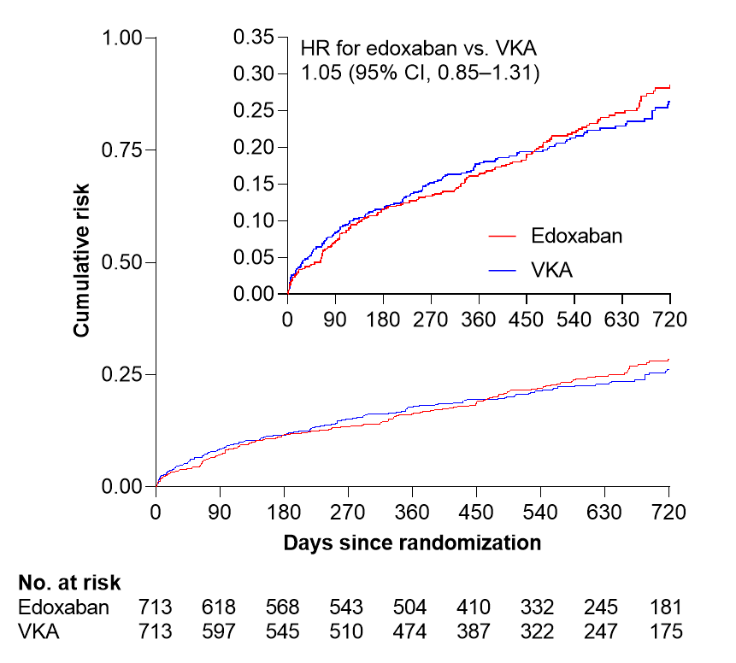
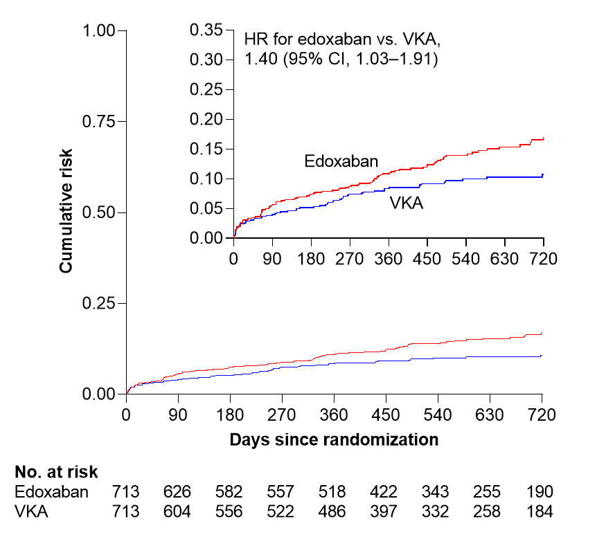
Primary efficacy and safety outcomes
NACE
Major bleeding
P = 0.014*
P = 0.927*
*Noninferiority P-value
CI, confidence interval; HR, hazard ratio; NACE, net adverse clinical events; VKA, vitamin K antagonist.
Notes:
21-11016-Dangas-AHR-MVH_13July2021_clean_v2_withfigs.docx, Fig 2

Slide 10

Unanswered questions

Slide 11
Differences across studies
Are all NOACs the same (in particular for safety)?
Are all NOAC doses used after TAVI equivalent?
Are dose adjustments done in the same type of patients?
Is antiplatelet therapy used similarly?
Is Introduction vs. Change vs. Continuation of an OAC the same?

Slide 12
Added value of ENVISAGE
(in place of warfarin)

Slide 13
ENVISAGE versus ATLANTIS
 | ENVISAGE (edoxaban vs VKA) | ATLANTIS (apixaban vs VKA)
Non-inferiority margin | 1.38 | 1.20
Number of patients | 1426 | 451
CTCA | NO | YES (70%)
CTCA | NO | YES (70%)
Dose-adjustment | 45% | 35%
VKA monitoring | YES | NO
CTCA | NO | YES (70%)
Any SAPT | 60% | 28%
Triple therapy | 10% | 3%
Drug discontinuation | 30% vs 40% | 8% vs 14%

Slide 14
ENVISAGE versus ATLANTIS
 | ENVISAGE (edoxaban vs VKA) | ATLANTIS (apixaban vs VKA)
Primary endpoint (NACE with BARC 3,4 or 5) | 170 (17.3%) vs 157 (16.5%) HR 1.05 (0.85 to 1.31)* | 49 (22·0%) vs 50 (21·9%) HR 1.02 (0.69-1.51)
Primary safety endpoint (BARC 3,4 or 5) | 89 (8.7%) vs 57 (5.8%) HR 1.52 (1.09, 2.12) | 23 (10·3%) vs 26 (11·4%) HR 0.91 (0.52-1.60)
 | ENVISAGE (edoxaban vs VKA) | ATLANTIS (apixaban vs VKA)
Death | 85 (7.8%) vs 93 (9.1%) HR 0.86 (0.64 to 1.15) | 23 (10·3%) vs 23 (10·1%) HR 1.04 (0.58-1.86)
Cardiovascular death | 49 (4.5%) vs 46 (4.5%) HR 1.00 (0.67 to 1.50) | 21 (9.4%) vs 15 (6.6%)
 | ENVISAGE (edoxaban vs VKA) | ATLANTIS (apixaban vs VKA)
Any stroke | 29 (2.7%) vs 35 (3.5%) 0.78 (0.48 to 1.28) | 8 (3.6%) vs 4 (1.8%) HR 2.1 (0.63 to 6.97)
Myocardial infarction | 12 (1.1%) vs 7 (0.7%) HR 1.65 (0.65 to 4.14) | 3 (1.3%) vs 2 (0.9%) HR 1.55 (0.26 to 9.30)
Valve thrombosis | 0 vs 0? | 2 (0.9%) vs 3 (1.3%) HR 0.67 (0.11 to 4.04)
Notes:
-Slide 15 : primary safety c’est 3.4.5 pour atlantis // c’est ISTH pour ENVISAGE
-Slide 15 : valve thombosis ils rapportent 0 dans chaque groupe en fait !!! le truc impossible a moins de ne pas les chercher

Slide 15
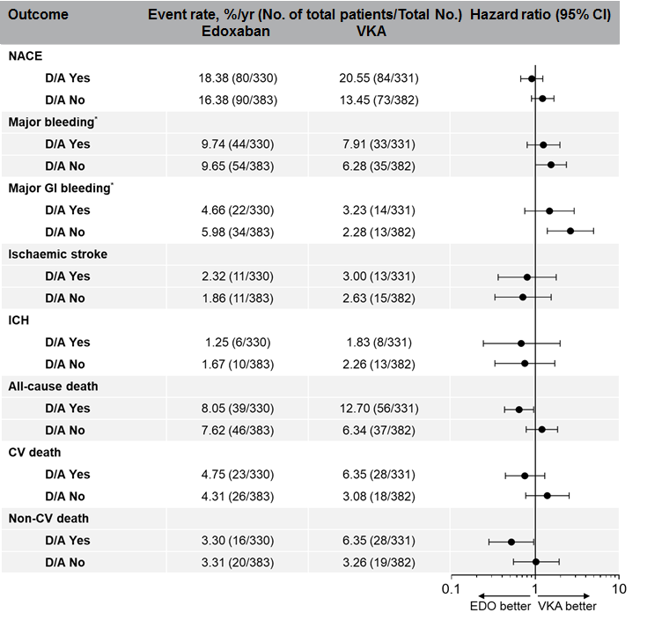
Safety issue
Edoxaban dose reduction to 30 mg in AF patients, if:
CrCl 15–≤50 ml/min
BW ≤60 kg†
P-gp inhibitors per local label†
†No dose reduction criteria in the US for AF
*ISTH definition
AF, atrial fibrillation; BW, body weight, CI, confidence interval; CrCl, creatinine clearance; CV, cardiovascular; D/A, dose adjustment; EDO, edoxaban; GI, gastrointestinal; ICH, intracerebral haemorrhage; ISTH, International Society on Thrombosis and Haemostasis; NACE, net adverse clinical events; VKA, vitamin K antagonist.

Slide 16
PENDING QUESTIONS
Justification of a Net Clinical Benefit in a non-inferiority trial ?
Justification of the upper boundary of the 2-sided 95% CI for the HR <1.38?
Why were patients overexposed to bleeding complications?
How valve thrombosis was searched, defined, reported?
Who should benefit from edoxaban after a successful TAVI ?
Notes:
A separate assessment of efficacy and safety is desirable in a noninferiority trial. Convincing evidence of non-inferiority with respect to efficacy coupled with safety advantage or advantage in cost, convenience, etc, would provide ample justification for the use of the new therapy.
La non-infériorité = perte d’efficacité consentie
Il faut connaître la valeur « min » de l’IC 95%
Il faut juger de la pertinence de la limite de non-infériorité
Il faut juger de l’avantage apporté par le nouveau produit
trop d'arrêts de traitement est embêtante

Slide 17

ENVISAGE_TAVI
Conclusions
01
Non-inferiority of edoxaban versus VKA is demonstrated → CONGRATULATIONS (the only positive trial with NOAC)!
02
More bleedings $$limited patient eligibility
03
NOAC safety depends on concomittant use of APT and dosing
04
Whether NOACs are the same after TAVI seems unlikely
05
It is time to update guidelines? Not sure…

Slide 18
Thank you!
www.action-groupe.org

