Slide 1
Aggressive detection and Management of the Extension of atherothrombosis in high Risk coronary patients In comparison with standard of Care for coronary Atherosclerosis The AMERICA study
AMERICA
AMERICA investigators www.action-coeur.org

Slide 2
Disclosures
Research grants from Bristol-Myers Squibb, Sanofi-Aventis, Eli Lilly, Guerbet Medical, Medtronic, Boston Scientific, Cordis, Stago, Centocor, Fondation de France, INSERM, Federation Francaise de Cardiologie, and Société Française de Cardiologie;
Consulting fees from Sanofi-Aventis, Eli Lilly, and Bristol-Myers Squibb; and lecture fees from Bristol-Myers Squibb, Sanofi-Aventis, and Eli Lilly.

Slide 3
AMERICA: Study organization
ACTION Study Group (www.action-coeur.org)
Academic Coordinating Center: Institute of Cardiology - Pitié-Salpêtrière, Paris
Academic Sponsor: AP-HP, Paris
Academic Global Trial Operations: URC - Lariboisière, Paris
Funding: ACTION, Institut de l’Athérothrombose
Steering Committee: G. Montalescot, JP Collet, G. Cayla, E. Vicaut,
Investigation sites : 28 French Intervention Centers

Slide 4
Centers and principal investigators
CHU Pitié-Salpêtrière, Paris, Drs Montalescot/Collet
Hôpital de la Timone, Marseille, Dr Cuisset
CH de Chartres, Dr Rangé
CHU Carémeau, Nîmes, Dr Cayla
CHU Montpellier, Dr Leclercq
CH de Lagny, Marne-la-Vallée, Drs Elhadad
Hôpital Lariboisière, Paris, Dr Henry, Sirol
CHU Saint-Antoine, Paris, Dr Cohen, Boccara, Edhery
Hôpital de Rangueil, Toulouse, Dr Carrié
CH Annecy, Dr Belle
CHRU Lille, Drs Ennezat/Van Belle
CHU Rennes, Dr LEBRETON, BEDOSSA, BOULMIER
CHU Caen, Dr BEYGUI, SABATIER
CHU Nantes, Dr FRESSONNET
CH Arras, Dr BEAREZ
CH Saint-Brieuc, Dr Mouquet, CLERC
CHU Dijon, Dr COTTIN, LHUILLIER, LORGIS, BUFFET
CH Cholet, Dr BOUVIER
CHU Amiens, Dr JARRY
CH Albi, Dr GALEY
CH Rambouillet, Dr FOURME
CH de Versailles, Dr LIVAREK

Slide 5
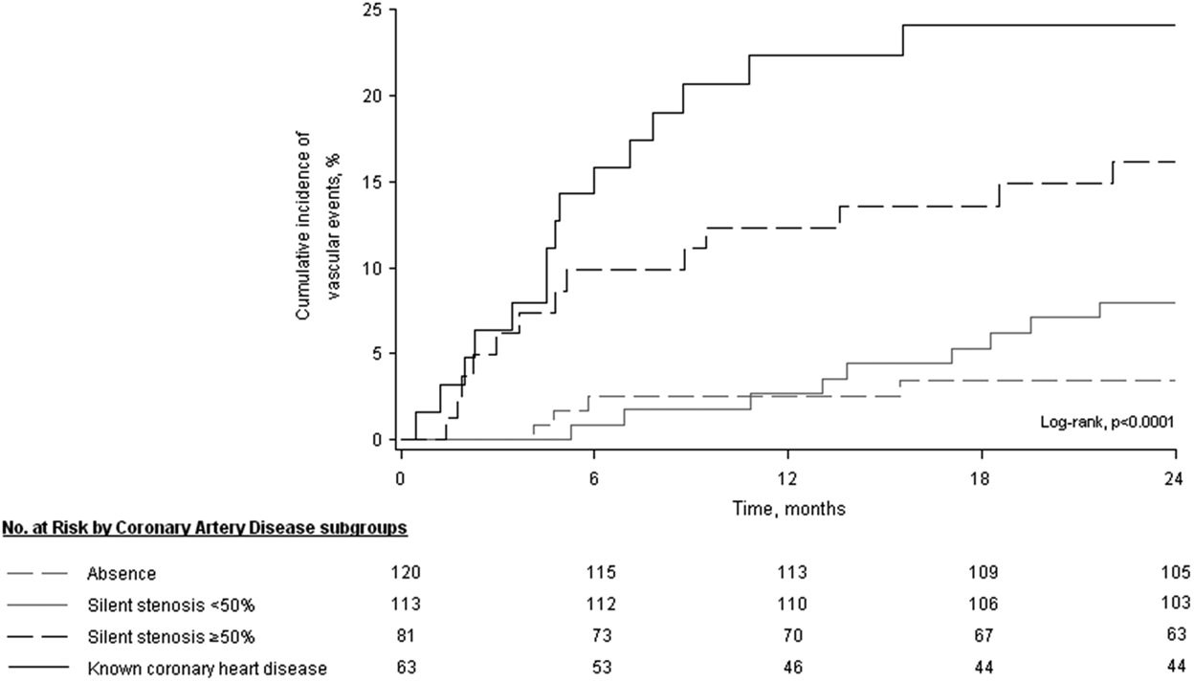
Background (1) Asymptomatic Myocardial Ischemia in Stroke and Atherosclerotic Disease (AMISTAD)
Known CAD
Asymptomatic Stenosis ≥50%
Asymptomatic stenosis <50%
No CAD
AMARENCO P. Stroke 2013;44:1505-11.

Slide 6
Background (2)
28
%
REACH Registry (n=68236 pts)
26,6
26
0
24
1
21,3
22
20
2
18
3
CV Events at 1 year
16
14
12,8
12
10
8
7,1
5,7
6
3,8
5,0
2,9
3,7
3,4
4
2,4
1,9
1,4
1,2
1,5
0,8
1,5
1,5
2
0,6
0,7
0
CV death
Non fatal MI
Non fatal stroke
CV death / MI / Stroke
CV death / MI / Stroke
Hospitalization
Steg PG et al JAMA. 2007 Mar 21;297(11):1197-206
Notes:
prevalence of carotid stenosis >70% was 5% (359). Among patients undergoing 2308 coronary angiography, the prevalence was as high as 7% in case of 3-vessel disease 2309 and 10% in case of left main coronary disease
INCREASE EVENT RATE BY 25%

Slide 7
ESC PAD Guidelines 2011
Patients with Lower Extremity Artery Disease associated with CAD are at twice the level of risk as those presenting with CAD alone.
Whether the management of CAD patients should differ in the case of concurrent LEAD is not obvious. There are no specific trials.
Eur Heart J. 2011 Nov;32(22):2851-906
Notes:
In summary, patients with LEAD associated with CAD are at twice the level of risk as those presenting with CAD alone. However, whether the management of CAD patients should differ in the case of concurrent LEAD is not obvious, because there are no specific trials related to this situation. To date, the co-existence of LEAD and CAD should only lead to closer attention, with a strict control of risk factors and the use of preventive treatments. Lowering the target for LDL cholesterol from 2.6 to
1.8 mmol/L should be considered. Regarding the use of antiplatelet therapy in stable CAD, given the greater benefits of clopidogrel vs. aspirin found in those with LEAD, clopidogrel rather than aspirin may be considered for the long-term treatment.38

Slide 8
AMERICA Study: Rationale (1)
Coronary artery disease→ the most frequent and severe location of atherosclerosis
Symptomatic multisite artery disease (MSAD) → integrator of the global CV risk
The prevalence and associated-risk of asymptomatic MSAD in high risk coronary patients are unknown.
Whether systematic identification of MSAD and treatment when appropriate combined with an aggressive secondary prevention is relevant has not been evaluated.

Slide 9
AMERICA Study: Rationale (2)
To demonstrate the superiority of a pro-active strategy of detection and management of the extension of atherothrombosis to other territories than coronary combined with an aggressive pharmacological secondary prevention strategy in a population with very high risk features of coronary disease (pro-active strategy)
As compared with a conservative strategy based on a clinically-guided identification of MSAD and standard pharmacological treatment (conventional strategy).
Notes:
The prevalence and associated-risk of asymptomatic multisite artery disease (MSAD) in high risk coronary patients are unknown. Whether systematic identification of MSAD and treatment when appropriate combined with an aggressive secondary prevention is clinically relevant has not been evaluated.

Slide 10
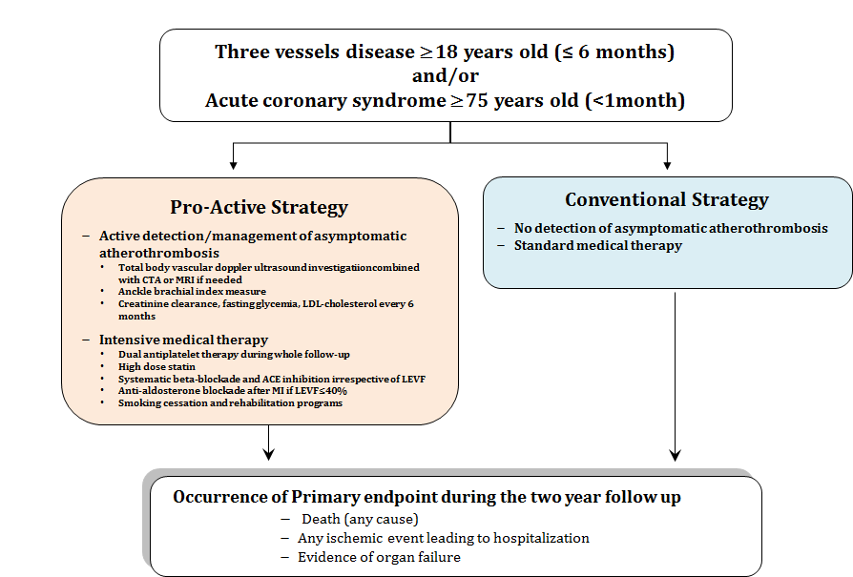
Study Design

Slide 11
 | Pro-active strategy | Conventional strategy
Detection of A∑ MSAD | ABI, duplex ultrasound or any other imaging procedure
Antiplatelet agent | DAPT during 24 months | DAPT for 12 months after ACS DAPT for 6 months after DES DAPT for one month after BMS
Lipid lowering therapy | Target LDL c levels < 70 mg/dl | Minimal effective dose
ACE inhibitors | Systematic use | LVEF≤40 % and/or MI or hypertension
Aldosterone blockade | After AMI or if LVEF<40% and Cr.Cl> 30 ml/min | No specific recommendations
Use of beta-blockers | Systematic with target resting rate <60 bpm. | Only after MI or LVdysfunction.
Blood pressure control | < 140/90 mm Hg in non-diabetic patient < 130/80 in diabetics or renal dysfunction | No specific recommendations
Management of diabetes | Systematic search of glycemic abnormalities Achieved HBA1c < 7% | No specific recommendations
Lifestyle | Smoking cessation with active counseling Promotion of regular physical activity Promotion of influenza vaccination | No specific recommendations

Slide 12
Definitions of MSAD
Aortic arch lesion was defined as any ulcerated and mobile plaque of > 4mm width
Significant extra-cranial carotid artery lesions: stenosis of ≥70% using duplex ultrasonography (DUS) or any other morphological investigation.
Atherosclerotic renal artery disease: lesion of 60% or more using DUS any other morphological investigation.
Asymptomatic aortic aneurism: ascending aorta of ≥45 mm or abdominal aorta of ≥50 mm using DUS any other morphological investigation.
Lower extremity artery disease (LEAD): Ankle brachial index of <0.9 or any stenosis of ≥70% or more using DUS or any other morphological investigation.
The prevalence of asymptomatic MSAD was defined as the presence of any above lesion.

Slide 13
AMERICA Study: Inclusion criteria
Patients (≥18 years) with recent (<6 months) established three-vessel disease defined as 70 % or more diameter stenosis in three vessels (Profile 1)
Recent (< 1month) acute coronary syndrome in elderly patient (≥75 years) defined by at least two of the following criteria (Profile 2):
Ischemic symptoms over 10 minutes
Electrocardiographic abnormalities : ST segment depression ≥0.1 mV (≥1 mm) or ST transitory elevation (< 30 min) in the ST segment≥0.1 mV (≥1 mm) or ST elevation>1 mm or more in two or more contiguous leads or new left bundle branch block
Positive troponin I or T (as defined locally)

Slide 14
AMERICA: Study Endpoints
Primary endpoint : death, any ischemic event leading to rehospitalization or any evidence of organ failure during the two-year follow-up period.
Organ failure: acute heart failure, new cognitive dysfunction, acute or worsening renal failure, new atrial or ventricular arrhythmia, and malignant hypertension.
Main secondary endpoint: All-cause death, MI, stroke or any revascularization.
Prespecified end points: prevalence of MSAD, each individual component of the primary end point, the number of hospitalizations.
The main safety end point: major bleeding (TIMI)

Slide 15
AMERICA Study: Statistical methodology
Considering a 24 month event rate in the conventional group at 33%*, a total sample size of N= 526 patients were needed to have a 80% power to detect a difference between the 2 strategies corresponding to an hazard ratio HR = 0.6 ( a 10% attrition rate was considered)
All efficacy analyses were based on the intention-to-treat principle using the full analysis set
The time from randomization to the first occurrence of any event for a given endpoint was compared using the Cox proportional hazards model at a 5% two-sided significance level
Interactions between treatment assignment and pre-specified subgroups were evaluated by including terms for treatment, subgroup and treatment-by-subgroup interaction in the Cox model
* JAMA 2003;289:1117–1123.

Slide 16
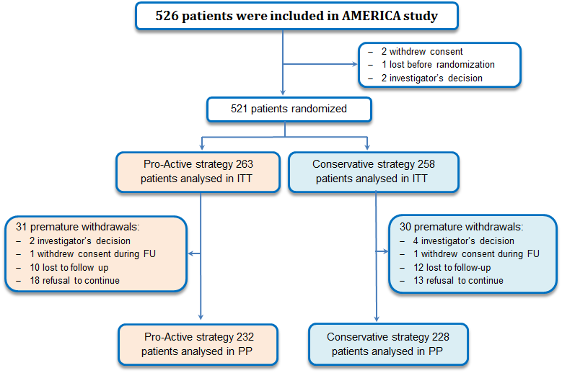
AMERICA: Consort diagram

Slide 17
Baseline Characteristics | Pro-active group (n=263) | Conventional group (n=258)
ACS in elderly (%) | 43% | 40%
Age: mean (→ %>75) | 77.7 (60%) | 76.0 (58%)
Women | 76 (28.9%) | 67 (26.0%)
Current smoker | 38 (14.4%) | 35 (13.6%)
Hypertension | 170 (64.6%) | 180 (69.8%)
Diabetes | 71 (27.0%) | 63 (24.4%)
Dyslipidemia | 147 (55.9%) | 150 (58.1%)
Severe renal failure | 9 (3.4%) | 11 (4.3%)
Prior myocardial infarction | 52 (19.8%) | 62 (24.0%)
Prior PCI | 54 (20.5%) | 61 (23.6%)
Peripheral artery disease | 22 (8.4%) | 28 (10.9%)
Prior Stroke | 20 (7.6%) | 13 (5.0%)

Slide 18
Clinical status at randomization | Pro-active group (n=263) | Conventional group (n=258)
Atrial fibrillation | 20 (7.6%) | 20 (7.8%)
ACS | 212 (80.6%) | 207 (80.2%)
Percutaneous coronary intervention | 201 (76.4%) | 201 (77.9%)
Drug Eluting stent | 82 (31.2%) | 73 (28.3%)
Bare Metal Stent | 119 (45.2%) | 128 (49.6%)
Coronary artery bypass graft | 22 (8.4%) | 21 (8.1%)
Left ventricle ejection faction < 40% | 42 (16.0%) | 35 (13.6%)
Cognitive dysfunction | 30 (19.0%) | 29 (19.3%)

Slide 19
AMERICA Study: Baseline Characteristics
Treatment at randomization | Pro-active group (n=263) | Conventional group (n=258)
Aspirin | 258 (98.1%) | 250 (96.9%)
Clopidogrel | 234 (89.0%) | 221 (85.7%)
Betablockers | 231 (87.8%) | 208 (80.6%)
ACE inhibitors | 187 (71.1%) | 175 (67.8%)
Statin | 248 (94.3%) | 241 (93.4%)
Aldosterone blockade | 18 (6.8%) | 13 (5.0%)
VKA | 26 (9.9%) | 26 (10.1%)
Insulin | 37 (14.1%) | 26 (10.1%)

Slide 20
AMERICA: Pro-active strategy
Treatment at randomization | Pro-active group (n=263) | Conventional group (n=258)
Screening for asymptomatic MASD | 100% | NA
Life style changes | 54% | NA
complete smoking cessation | 61.7% | NA
ACE inhibitors | 85.9% | 71.7%*
beta-blockade was given | 87.8% | 81.4%*
Interruption of DAPT | 1.2% | 4.9%*

Slide 21
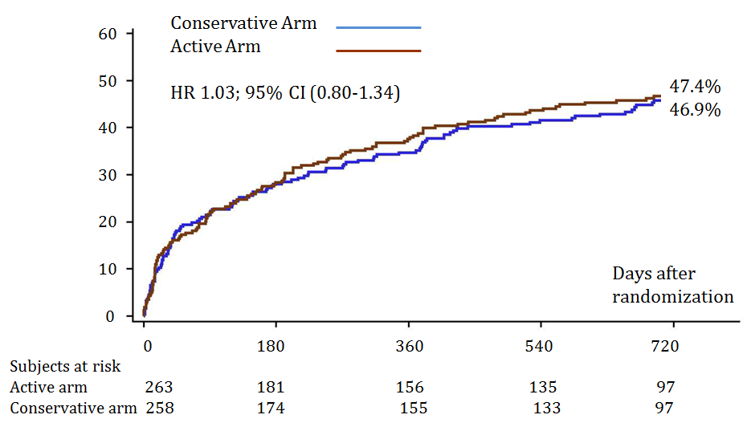
Primary Endpoint at 2 years-FU*
* death, any ischemic event leading to rehospitalization or any evidence of organ failure

Slide 22
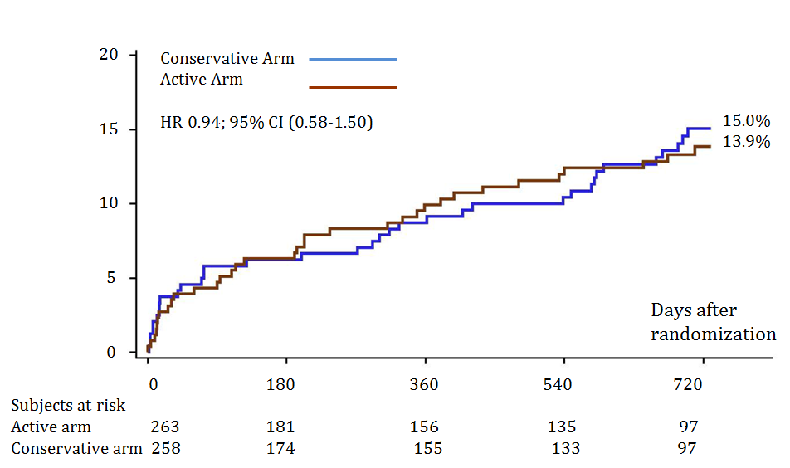
Main secondary endpoint at 2 years-FU*
* All-cause death, MI, stroke or any revascularization
Subjects at risk:
Active arm 263 236 223 208 147
Conservative arm 258 226 217 205 147

Slide 23
Key secondary outcomes | Pro-active Arm (n=263) | Conventional Arm (n=258) | Hazard Ratio (95% CI) | p-value
All-cause mortality | 23 (8.7%) | 28 (10.9%) | 0.78 (0.45-1.35) | 0.37
Myocardial infarction | 36 (13.7%) | 25 (9.7%) | 1.39 (0.83-2.31) | 0.21
Stroke | 6 (2.3%) | 5 (1.9%) | 1.13 (0.35-3.72) | 0.83
Critical Limb ischemia | 6 (2.3%) | 1 (0.4%) | 5.73 (0.69-47.60) | 0.11
AAA fissuration | 1 (0.4%) | 0 (0.0%)
Revascularization | 77 (29.3%) | 56 (21.7%) | 1.36 (0.96-1.91) | 0.083
PCI | 63 (24.0%) | 50 (19.4%) | 1.21 (0.84-1.76) | 0.31
Coronary artery bypass graft | 17 (6.5%) | 8 (3.1%) | 2.04 (0.88-4.73) | 0.09
Organ failure | 38 (14.4%) | 37 (14.3%) | 0.97 (0.62-1.53) | 0.91

Slide 24
Key seconday outcomes
 | Pro-active Arm (n=263) | Conventional Arm (n=258) | Hazard Ratio (95% CI) | p-value
Safety endpoints
All bleeding | 29 (11.0%) | 22 (8.5%) | 1.28 (0.73-2.22) | 0.38
Major bleeding (TIMI) | 12 (4.6%) | 13 (5.0%) | 0.87 (0.40-1.91) | 0.73
Hospitalizations (yes) | 104 (39.5%) | 85 (32.9%) |  | 0.11

Slide 25
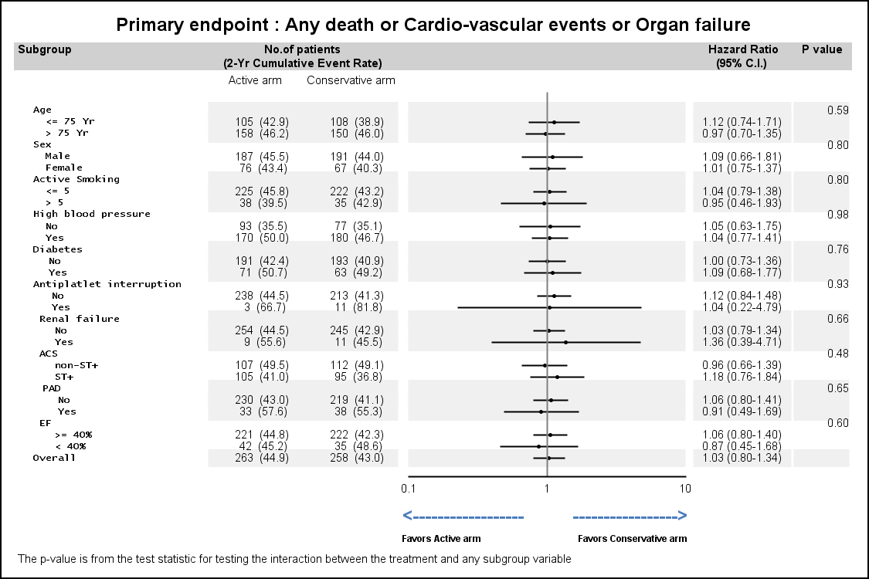
Prespecified subgroups

Slide 26
Limitations
Identification of MSAD was infrequent and revascularization was rare.
Pharmacological treatment was close to optimal in both groups limiting the impact of a pro-active strategy.
Side effects of pharmacological secondary prevention are obvious limitations to the pro-active strategy in elderly.
Ticagrelor and prasugrel were not approved or there was no possibility to use the drugs (prasugrel 5 mg in the elderly).

Slide 27
Limitations
Benefit of aldosterone blockade and of intensified LDL-cholesterol lowering therapies were not proven at the time the study was launched.
Life style changes were not satisfactory and were according to the lack of benefit of individualized education program on lifestyle risk factors to improve cardiovascular risk factors control.
AMERICA was powered enough to answer our initial hypothesis with a reported event rate higher than what we anticipated.

Slide 28
Conclusions
AMERICA

Slide 29
Conclusions
Asymptomatic MSAD is identified in one out of five high risk CAD patients
AMERICA does not support the routine detection of asymptomatic MSAD even in high coronary risk patients as those recruited in the trial while aggressive secondary prevention strategy appears to be the standard of care already.

Slide 30
Back-up

Slide 31
Localisation of MSAD (n=56)
 | Pro-active group (n=263)
Aortic arch | 1 (2%)
Carotid (extra and intracranial) | 9 (4.5%)
Aortic Abdominal Aneurism ≥50mm | 1 (0.5%)
Aortic Abdominal Aneurism <50mm | 11 (5.9%)
Renal artery disease | 6 (3.5%)
Visceral arteries | 4 (2.5%)
Femoro-iliac stenosis | 27 (13.8%)

Slide 32
Management of MSAD
 | Pro-active group (n=263)
ABI <0.9 | 28 (21.7%)
Imaging procedure | 208 (79%)
Rate of identification | 56 (21.3%)
Revascularization procedures | 2 (3.7%)

Slide 33
Independent predictors of MSAD
 | HR | 95% CI | P
CABG | 5.054 | 1.180-21.647 | 0.0290
BMI (kg/m2) | 0.841 | 0.759-0.931 | 0.0009
Kaliemia (mmol/L) | 3.017 | 1.378-6.605 | 0.0057
Notes:
Asymptomatic MSAD was identified in 21% (n=56) of the patients assigned to the pro-active strategy. The most frequent locations were lower limb extremities (n=27), aortic aneurism (n=12) and carotid artery disease (n=11). Renal artery disease and aortic arch were more rarely found (n=6 and 1, respectively). MSAD identification led to a specific revascularization procedure in only two patients out of 56. Patients with asymptomatic MSAD were older (74.9±11.8 vs. 72.4±11.1, p=0.16) and had a lower body mass index (24.6±3.6 vs. 26.8±4.0, p=0.0003), had more frequently severe renal failure (7.1% vs. 2.6%, p=0.13), COPD (8.9% vs. 3.3%, p=0.09), cancer (16.1% vs. 11.3%, p=0.35) and atrial fibrillation (10.9% vs. 4.7%, p=0.10). These patients had also more frequently a prior history of CABG (12.7% vs. 4.0%, p=0.02) or myocardial infarction (26.8% vs. 16.6%, p=0.09), symptomatic PAD (17.9% vs. 6.6%, p=0.01), and presented less frequently with ST-elevation myocardial infarction (54.5% vs. 74.4%, p=0.037) compared with patients assigned to the pro-active strategy and without asymptomatic MSAD. Risk factors independently associated with asymptomatic MSAD after multivariate analysis were low BMI (OR 0.84, 95%CI 0.76-0.93), prior CABG (OR 5.05, 95% CI 1.18-21.65) and hypokaliemia (OR 3.02, 95% CI 1.38-6.61).

